Slide 1


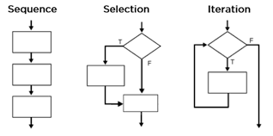
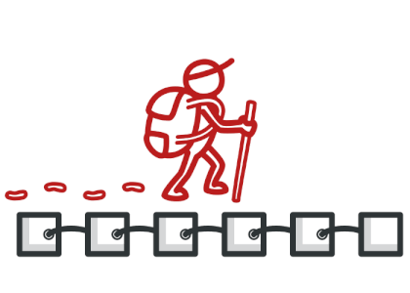
Controlla-palooza
Everything you never learned about how code executes!
Expression
Evaluation
Short Circuiting
Flow Control
Iterators

Slide 2

Expression Evaluation
What’s the big picture?
Expressions like
f(x) + g(x)
are evaluated differently by different languages!
For example, does the language evaluate from right to left, left to right, or is there no specified order?
If these function calls don't have side effects, then the order of execution doesn't matter.
But if these functions do have side effects, the order of evaluation of an expression must be considered!

Slide 3
Expressions and Their Evaluation
Happy
Anticipating the final exam
Notes:
A statement is a unit of program execution that expresses an action to be carried out
Statements generally don't result in a value – they simply carry out an action.

Slide 4
Expressions
An expression is a combination of values, function calls and operations that, when evaluated, produces an output value.
An expression may or may not have side effects.
Which of the following are expressions?
f(x)*5
if (foo)
cout << "bar";
b =
a = 5
a && (b || c)
if a > 5 then a*3 else a*4
Notes:
A statement is a unit of program execution that expresses an action to be carried out
Statements generally don't result in a value – they simply carry out an action.

Slide 5

Expressions, Associativity and Order of Evaluation
So if f() has a side effect, this could impact the result!
Similarly if f() has a side effect, the results can change!
Challenge: What will these C++ programs print? Why?
Thinking time!
int c = 1, d = 2;
int f() {
++c;
return 0;
}
int main() {
cout << c - d + f() ;
}
Why? C++ doesn't specify what order the terms of an arithmetic expression must be evaluated!
int c = 0;
int f() {
++c;
return c;
}
void h(int a, int b)
{ cout << a << " "<< b; }
int main() {
h(c, f());
}
Nor does it specify what order parameters must be evaluated!
Some languages mandate a left-to-right eval order (C#, Java, JavaScript, Swift), while others don't (Rust, OCaml).
The value of c could be evaluated first...
Or perhaps the value of f() could be evaluated first!
The value of c could be evaluated first...
Or perhaps the value of f() could be evaluated first!
Answer:
Either -1, or 0
Answer
Either 0 1, or 1 1
Challenge: What's the rationale behind not specifying a strict order?
Thinking time!
Notes:
Answer: It provides the compiler with latitude to optimize the code by reordering instructions to maximize execution speed

Slide 6

Expressions, Associativity and Order of Evaluation
Academic Robot Says:
"There are a few exceptions, Carey:
Exponentiation is often right- associative: 2^3^2 → 512
Assignment is right associative: a = b = c = 5 → c=5; b=c; a=b;
Unary operators are right associative:
~!a → ~ (!a)"
int c = 1, d = 2;
int f() {
++c;
return 0;
}
int main() {
cout << c - d + f() ;
}
Regardless what order each of the terms are evaluated...
int c = 0;
int f() {
++c;
return c;
}
void h(int a, int b)
{ cout << a << " "<< b; }
int main() {
h(c, f());
}
And not this...
Most languages use left-to-right associativity when evaluating mathematical expressions.
Which is the way we all learned to do it in school.
( )
( )
So expressions like this will be evaluated implicitly like this...
Notes:
sequence point

Slide 7
Short Circuiting
Challenge: What will these programs print?
Thinking time!
Why? Let's see!
int f()
{ cout << "UCLA "; return 5; }
int g()
{ cout << "students "; return 10; }
int h()
{ cout << "are "; return 20; }
int main() {
if (f() < 10 && g() < 5 && h() > 9)
cout << "awesome";
}
int f()
{ cout << "CS131 "; return 5; }
int g()
{ cout << "has "; return 10; }
int h()
{ cout << "no "; return 20; }
int main() {
if (f() < 10 || g() > 5 && h() > 9)
cout << "rules";
}
Answer:
UCLA students
Answer
CS131 rules
Notes:
Left to right: Rust, Java

Slide 8
Short Circuiting: How it Works
Consider the expression below:
bool cute = true;
if (cute == true || smart == true || rich == true)
cout << “Hey, want to go on a date?”;
If you’re either cute, or smart, or rich, then I’d like to go out with you.
Let’s say that I happen to know you’re cute.
Once I know you’re cute, I no longer need to waste time asking the other two questions…

Slide 9
Short Circuiting: How it Works
Short circuiting applies to any boolean expression, not just if statements, e.g.,
bool result = cute || smart || rich;
if (cute == true || smart == true || rich == true)
cout << “Hey, want to go on a date?”;
bool cute = false, smart = true;
This is called short-circuiting.
In any boolean expression with AND / OR, most languages will evaluate its sub-expressions from left-to-right…
The moment the language finds a condition that satisfies or invalidates the boolean expression, it will skip evaluating the rest of the sub-expressions.
This can dramatically speed up your code!

Slide 10
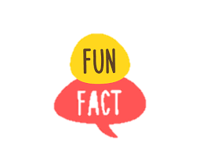
Short Circuiting... What's Happening?
What You Write...
What's Happening
Short Circuiting is AKA McCarthy evaluation since John McCarthy (who invented Lisp and Garbage Collection) invented the approach.
if (is_cute())
date_person();
else if (is_smart())
date_person();
else if (is_rich())
date_person();
if(is_cute() || is_smart() || is_rich()) {
date_person();
}
if (good_salary()) {
if (fun_work()) {
if (good_culture()) {
take_job();
}
}
}
if (good_salary() && fun_work() && good_culture()) {
take_job();
}

Slide 11
Short Circuiting
If the user passed in a nullptr, then we abort evaluating the later part of the expression.
Here's a typical use of short-circuiting:
void assign_letter_grade(CourseResults *ptr) {
if (ptr != nullptr && ptr->score > 95)
ptr->grade = "A+";
...
}
This code would crash!
If the language didn't have short circuiting, and the user passed in nullptr...
// without short circuiting
void assign_letter_grade(CourseResults *ptr) {
if (ptr != nullptr) {
if (ptr->score > 95)
ptr->grade = "A+";
}
...
}
And just continue with the following code.
We'd have to introduce a second if statement, perhaps with additional nesting of blocks. Yuck!
This can actually make our code much simpler/less wordy!

Slide 12
Classify That Language: Short Circuiting
fun rich(salary: Int): Boolean {
if (salary > 200000) return true;
print("Not in silicon valley!\n")
return false
}
fun main() {
val cute = true; val smart = false;
val salary = 200000;
if (cute == true || smart == true || rich(salary) == true)
print("You're my type!\n")
if (cute == true or smart == true or rich(salary) == true)
print("I still want to date you!\n")
}
The code to the left prints out the following:
You're my type!
Not in silicon valley!
I still want to date you!
What can we say about how this language implements short circuiting?
This is Kotlin!
Thinking time!
Notes:
Answer: Kotlin supports two types of boolean expressions – those with short circuiting (using && ||) and those that do full evaluation (and, or). In the later case, every term is evaluated even if earlier terms are sufficient to exit the if statement.

Slide 13
Language Of The Week: Ruby
def add_method(klass, func_name, params, expr)
method_str = "def #{func_name}(#{params}); #{expr}; end"
klass.class_eval(method_str)
end
# Let's create an empty class
class Foo
# empty class
end
# Let's dynamically add methods to Foo class
add_method(Foo, "f", "x, y", "x*5+y")
add_method(Foo, "area", "r", "Math::PI*r**2")
# Use our dynamically created methods!
q = Foo.new
puts q.f(10, 2) # Prints 52
puts q.area(1) # Prints 3.141592653589793
def add_method(klass, func_name, params, expr)
method_str = "def #{func_name}(#{params}); #{expr}; end"
klass.class_eval(method_str)
end
# Let's create an empty class
class Foo
# empty class
end
# Let's dynamically add methods to Foo class
add_method(Foo, "f", "x, y", "x*5+y")
add_method(Foo, "area", "r", "Math::PI*r**2")
# Use our dynamically created methods!
q = Foo.new
puts q.f(10, 2) # Prints 52
puts q.area(1) # Prints 3.141592653589793
History
Ruby was released in 1995 by Japanese computer scientist Yukihiro "Matz" Matsumoto. His goal was to create an easy to use, true OOP scripting language.
Programming Language of The Week
Overview
Ruby is an OOP scripting language with dynamic typing and garbage collection. Like Python, *everything* is an object in Ruby. Ruby is super-fast to code/prototype in.
Unique Aspects
Ruby is known for its metaprogramming features, which enable Ruby code to dynamically create/modify functions, classes, and methods at runtime - aka self-modifying code!
Impact
Ruby (via Ruby on Rails) is popular in web development, and has been used by companies as diverse as Apple and Twitter.
Notes:
Developed by Apple, AMD, Nvidia and others, OpenCL was released in 2008 to simplify parallel programming of a diverse set of GPU accelerator chips.

Slide 14
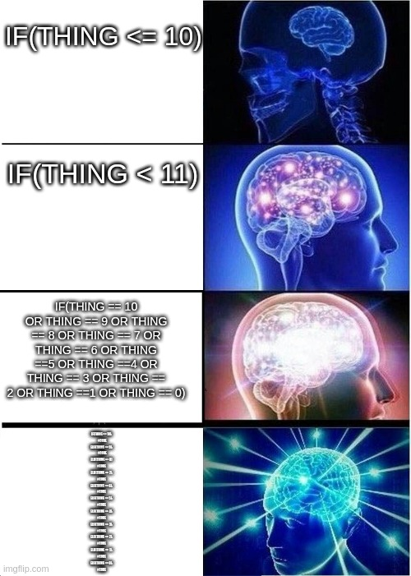
Control Statements

Slide 15
Control Flow
What’s the big picture?
There are three major categories of control flow:
Unconditional Branching Statements:
goto, break, return, and continue
Conditional Statements:
if/else, switch, guards, etc.
Loops:
while, do-while, for, foreach, etc.
Next, we'll do a quick survey of these control structures, and learn some interesting variations.

Slide 16
Unconditional Branching Statements
GOTO
BREAK
if (condition_is_true) goto here;
...
here:
do_other_thing();
while (condition_is_true) {
...
if (other_condition_is_met)
break;
...
}
...
CONTINUE
RETURN
while (condition_is_true) {
...
if (other_condition_is_met)
continue;
...
}
{
...
if (condition_is_true)
return result;
...
}
Let's dive a bit into goto, break and continue.

Slide 17
Unconditional Branching: GOTO
// C++ goto example using
// string labels
int main() {
for (int i=0;i<10;++i) {
...
if (foo(i)) goto done;
...
}
done:
...
}
One of the earliest flow-control statements was GOTO.
In early programming languages, you could assign names (aka labels) to lines in your program.
A label might be a string...
And then use the GOTO statement to transfer control to a specific line based on its label.
0 REM GOTO EXAMPLE IN BASIC
1 REM USING NUMERIC LABELS
10 PRINT "HELLO WORLD"
20 GOTO 10
Or it might be numeric

Slide 18
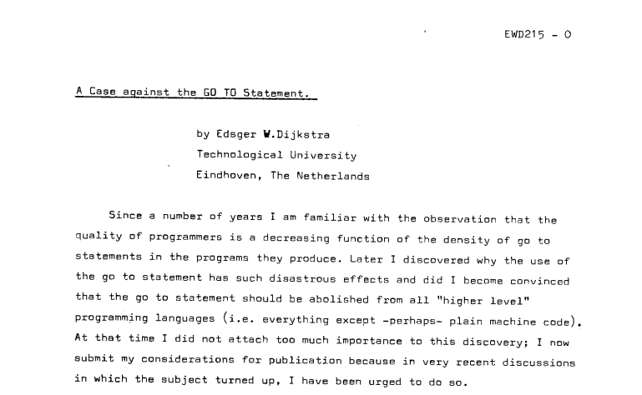
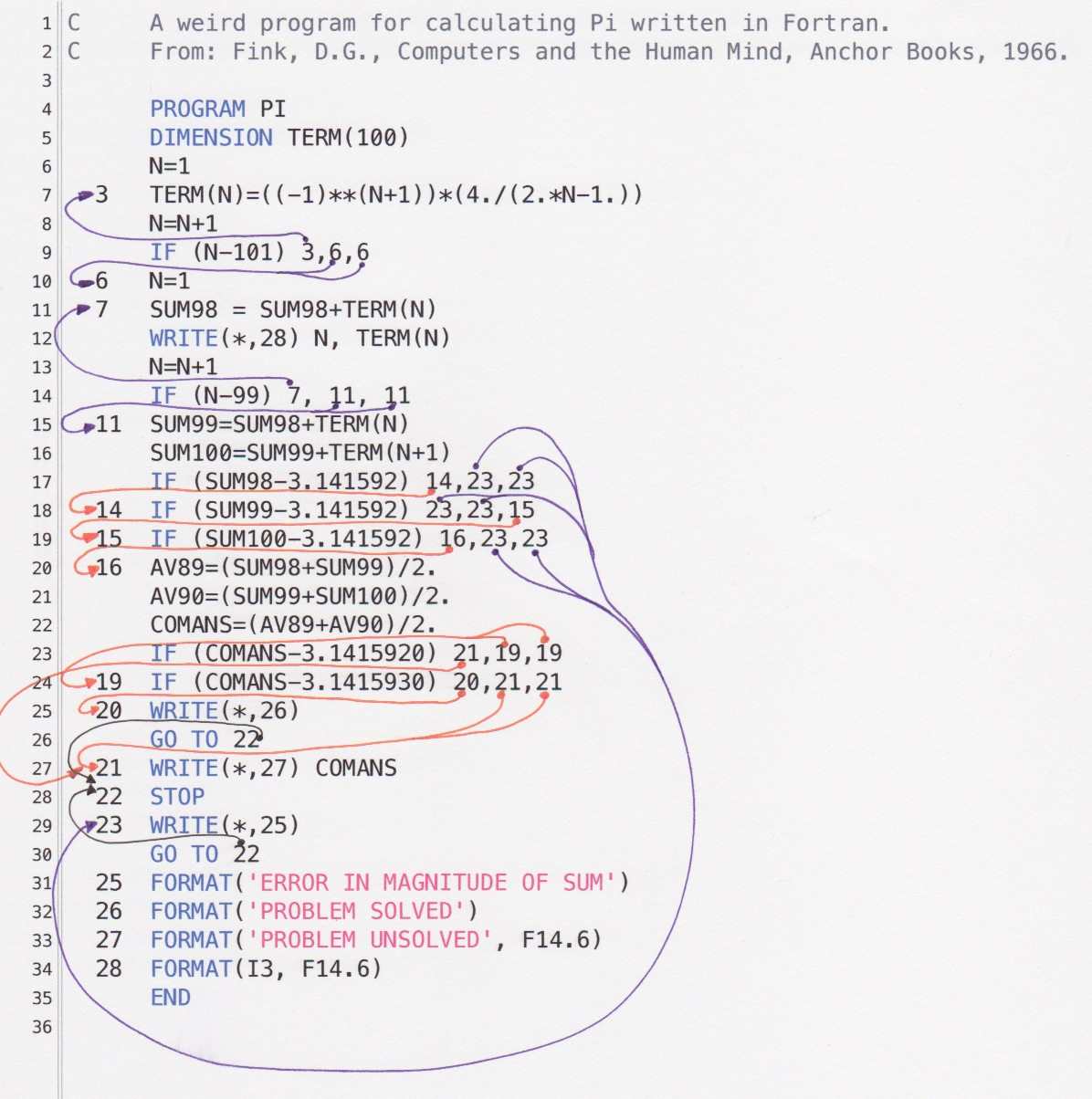
Unconditional Branching: Goto
The Linux Kernel written in C contains roughly 100,000 GOTO statements!
// C++ goto example
int main() {
int i, j;
cin >> i;
if (i > 10)
goto inside;
for(j=0;j<20;++j) {
...
inside:
cout << j << endl;
}
}
Using GOTO statements is generally frowned upon in modern software engineering. Why?
Thinking time!
Notes:
Answer: Improper use of GOTO statements can lead to "spaghetti" code with difficult to understand semantics.
Dijkstra's memo: https://www.cs.utexas.edu/users/EWD/ewd02xx/EWD215.PDF
It was published in '68.
For more arguments against GOTOs, see:
https://softwareengineering.stackexchange.com/questions/334417/what-kind-of-bugs-do-goto-statements-lead-to-are-there-any-historically-signi
Code using structure programming, with clear nested blocks and loops or switches, is easy to follow; its flow of control is very predictable. It's therefore easier to ensure that invariants are respected.
With a goto statement, you break that straightforward flow, and break the expectations. For example, you might not notice that you have still to free resources.
Many goto in different places can send you to a single goto target. So it's not obvious to know for sure the state you are in when reaching this place. The risk of making wrong/unfounded assumptions is hence quite big.
It is about scope. One of the main pillars of good programming practice is keeping your scope tight. You need tight scope because you lack the mental ability to oversee and understand more than just a few logical steps. So you create small blocks (each of which becomes "one thing") and then build with those to create bigger blocks which become one thing, and so on. This keeps things manageable and comprehensible.
A goto effectively inflates the scope of your logic to the entire program. This is sure to defeat your brain for any but the smallest programs spanning only a few lines.
So you will not be able to tell if you made a mistake anymore because there is just too much to take in and check for your poor little head. This is the real problem, bugs are just a likely result.

Slide 19

Unconditional Branching: Break and Continue
As you hopefully remember from CS31...
The break statement terminates the innermost loop and execution jumps to the statement following it.
The continue statement jumps to the top of the innermost loop and advances to the next loop iteration.
int main() {
for (int i=0; i<3; ++i) {
for (int j=0; j<10; ++j) {
if (j == 0)
break;
cout << j << endl;
}
cout << i << endl;
}
}
int main() {
for (int i=0; i<3; ++i) {
for (int j=0; j<10; ++j) {
if (j == 0)
continue;
cout << j << endl;
}
cout << i << endl;
}
}
All remaining iterations skipped!
Continues the loop here!
Skipped
Skipped
But in modern languages, break and continue have evolved! Let's see how!

Slide 20
Unconditional Branching: Break and Continue
Academic Robot Says:
The language finds the loop associated with the label.
"A growing number of languages including Java, JavaScript, Kotlin and PHP now have labelled breaks and continues!"
// JavaScript
outer_loop:
for (i = 0; i < 100000; i++) {
console.log("outer: " + i)
for (j = 0; j < 100000; j++) {
console.log("inner: " + j)
if (j == 2) break outer_loop;
}
}
console.log("done!")
Challenge: What output does this code produce? Why?
Thinking time!
outer: 0
inner: 0
inner: 1
inner: 2
done!
The language finds the loop associated with the label.
If you hit a labelled break...
Challenge: What output does this code produce? Why?
// Kotlin
outer@ for (i in 1..3) {
println("outer: $i")
inner@ for (j in 1..100) {
println("inner: $j")
if (j==1) continue@outer
}
}
println("done!")
And then immediately breaks out of all inner loops and jumps to the labelled loop for the next iteration.
And then exits every nested loop and continues running the line after the end of the labeled loop.
outer: 1
inner: 1
outer: 2
inner: 1
outer: 3
inner: 1
done!
Thinking time!
If you hit a labelled continue...

Slide 21

Conditionals

Slide 22

Conditionals: If Statements
If the expression's value was zero, the IF would transfer control to the second line number.
If the expression's value was positive, the IF would transfer control to the third line number.
If the expression's value was negative, the IF would transfer control to the first line number.
We all know and love if statements...
In Fortran, you could place line numbers in front of statements to identify those lines, and jump to them.
When a Fortran program reached an IF statement...
So where did the first if statement come from?
Let's see how it worked!
WRITE (*,*) 'Enter a # :'
READ (*,*) n
IF ( n ) 10, 100, 2000
...
10 WRITE (*,*) 'n is less than zero'
...
...
100 WRITE (*,*) 'n is equal to zero'
...
...
2000 WRITE (*,*) n is greater than zero' ...
This means that the code you'd execute might be thousands of lines away!
EEK!
It would evaluate the expression between the parentheses...
Since if statements are uniform across languages, let's learn some related conditionals.
Notes:
-- OCaml guards let select_beverage a =
match a with
| a when a < 21 -> "Coke"
| a when a >= 21 -> "Beer"
;;
-- Haskell guards select_beverage age
| age < 21 = "Coke"
| otherwise = "Beer"

Slide 23

Conditionals: Beyond If Statements
In Kotlin, this is called the elvis operator because if you turn it on its side, it looks like Elvis!
Hopefully you've seen C++'s conditional ternary operator – it's an operator with 3 operands!
Here are its semantics: If boolean_condition is True return A else return B
// C++, C#, Java, JavaScript, Swift, etc. beverage = age < 21 ? "Coke" : "Beer";
?:
# Python conditional operator beverage = "Coke" if age < 21 else "Beer"
// Kotlin conditional operator beverage = if age < 21 "Coke" else "Beer"
// Kotlin
fun eat_startup_meal(food: String?) {
val meal = (food ?: "ramen") + " and redbull"
println("Time for dinner, let's have $meal.")
}
fun main(args: Array<String>) {
// Running out of funding
eat_startup_meal(null)
// Just raised a round
eat_startup_meal("sushi")
}
Challenge: Here's a related operator.
What does it do?
This is called the null coalescing operator.
A ?: B means:
If A is not NULL return A, else return B
Thinking time!
Time for dinner, let's have ramen and redbull.
Time for dinner, let's have sushi and redbull.
// C#, JavaScript, Swift, etc.
meal = food ?? "ramen";
Notes:
-- OCaml guards let select_beverage a =
match a with
| a when a < 21 -> "Coke"
| a when a >= 21 -> "Beer"
;;
-- Haskell guards select_beverage age
| age < 21 = "Coke"
| otherwise = "Beer"

Slide 24
Conditionals: Beyond If Statements
if (perks == null)
return null
else if (perks.weekend_meals == null)
return null
else
return perks.weekend_meals.breakfast
And here's one more variation!
Challenge: The following program produces the output on the right. What does the ? operator do?
Thinking time!
// Javascript
function sunday_brunch_at_the_office(perks) {
var meal = perks?.weekend_meals?.breakfast
if (meal != null) console.log("Let's eat " + meal)
else console.log("You're on your own.")
}
sunday_brunch_at_the_office(null)
var menu = {breakfast: "eggs", lunch: "ramen", dinner: "ribs"}
var perks = {weekday_meals: menu}
sunday_brunch_at_the_office(perks)
perks["weekend_meals"] = menu
sunday_brunch_at_the_office(perks)
You're on your own.
You're on your own.
Let's eat eggs
This is called the safe navigation operator.
Notes:
-- OCaml guards let select_beverage a =
match a with
| a when a < 21 -> "Coke"
| a when a >= 21 -> "Beer"
;;
-- Haskell guards select_beverage age
| age < 21 = "Coke"
| otherwise = "Beer"

Slide 25
Conditionals: Multi-way Selection
Fortran expects this value to be between 1-4
Since there are 4 line numbers here...
Everyone loves the switch statement...
Let's see what its ancestor looked like.
You guessed it – it's from Fortran!
This is Fortran's equivalent of a switch statement!
cout << "Enter a number between 1-4: ";
cin >> n;
switch (n) {
case 1:
cout << "Running code for case 1';
break;
case 2:
cout << "Running code for case 2';
break;
case 3:
cout << "Running code for case 3';
break;
case 4:
cout << "Running code for case 4';
break;
}
WRITE (*,*) 'Enter a # between 1-4:'
READ (*,*) n
GO TO ( 10, 25, 50, 100 ), n
...
10 WRITE (*,*) 'Running code for case 1'
...
25 WRITE (*,*) 'Running code for case 2'
...
50 WRITE (*,*) 'Running code for case 3' ...
100 WRITE (*,*) 'Running code for case 4' ...
If n is out of range, then execution continues here!
Then it jumps to that line to run the instructions there.
When the code reaches this line, this variable is used to select one of these line numbers.
It was janky, but it worked...

Slide 26
Conditionals: Multi-way Selection
Ok, let's briefly review switch's C++ syntax/semantics, then see variations from different languages.
// C++ switch statement
int drinks = 4;
switch (drinks)
{
case 1:
case 2:
case 3:
cout << "I'm chillin\n";
break;
case 4:
cout << "I'm lit!\n";
cout << "Life is good!\n";
default:
cout << "puke!\n";
break;
}
We can have multiple cases together, but they must be listed one per line.
No { } are required for multiple statments.
All cases must be constant char/int/enum values.
If you don't include a break statement, the program keeps running until you hit one.

Slide 27
Conditionals: Multi-way Selection
Challenge: This Swift code produces the following output. How does Swift's switch differ from C++'s?
// C++ switch statement
int drinks = 4;
switch (drinks)
{
case 1:
case 2:
case 3:
cout << "I'm chillin\n";
break;
case 4:
cout << "I'm lit!\n";
cout << "Life is good!\n";
default:
cout << "puke!\n";
break;
}
Thinking time!
You can have non-scalar values for your labels.
// Swift
var name = "Paul"
switch name {
case "Carey":
print("Haskell is easiest")
print("Smalltalk is confusing")
case "Paul", "Todd":
print("OCaml is lit!")
default:
print("Fortran rocks!")
}
You don't need break to prevent fall-through.
Oh, and BTW, Swift's switch must be exhaustive, or have a default case for it to compile!
Ocaml is lit!
Notes:
Swift – also can't have multiple cases together for a single block:
case 1:
case 2:
case 3:
print("foo") is invalid

Slide 28
Conditionals: Multi-way Selection
Challenge: What are all the ways Kotlin's switch statement differs from C++'s?
// C++ switch statement
int drinks = 4;
switch (drinks)
{
case 1:
case 2:
case 3:
cout << "I'm chillin\n";
break;
case 4:
cout << "I'm lit!\n";
cout << "Life is good!\n";
default:
cout << "puke!\n";
break;
}
// Kotlin
var drinks: Int = 4;
when (drinks) {
in 1..3 -> println("I'm chillin")
4 -> {
println("I'm lit!")
println("Life is good!")
}
else -> println("puke!");
}
You can use ranges for labels.
We need bracers to have multiple statements.
Break is not needed – execution stops at the end of the each case and doesn't fall through!
// Go
switch {
case age >= 1 && age <= 2:
eat = "milk";
case age >= 3 && age <= 5:
eat = "smooshed peas";
case age > 5:
eat = "junk food";
}
We use "else" instead of default.
I'm lit
Life is good!
Thinking time!

Slide 29
Conditionals: Multi-way Selection
Challenge: What are all the ways Python's switch differs from C++'s?
// C++ switch statement
int drinks = 4;
switch (drinks)
{
case 1:
case 2:
case 3:
cout << "I'm chillin\n";
break;
case 4:
cout << "I'm lit!\n";
cout << "Life is good!\n";
default:
cout << "puke!\n";
break;
}
Thinking time!
You can pattern match and refer to variables from the pattern!
You can match against strings, lists, and dictionaries.
def greet(x):
match x:
case 'person':
print('Hi person!')
case [p1, p2]:
print(f'Hi {p1} and {p2}!')
case {'name': n, 'age': a}:
print(f"Welcome {n}, you're {a}")
case p if 'berg' not in p:
print(f'Hello, {p}!')
case p:
print(f'Go away, {p}!')
greet('Bjarne')
There's no break statement needed to prevent fall-thru.
You can place conditions on your matches.
Hello, Bjarne!
Notes:
Swift – also can't have multiple cases together for a single block:
case 1:
case 2:
case 3:
print("foo") is invalid

Slide 30
Conditionals: Multi-way Selection
Challenge: Go has traditional switch statements, and also this form. How does this version differ from C++'s?
We've omitted an expression to switch on, e.g.,:
switch (expr) { ... }
// C++ switch statement
int drinks = 4;
switch (drinks)
{
case 1:
case 2:
case 3:
cout << "I'm chillin\n";
break;
case 4:
cout << "I'm lit!\n";
cout << "Life is good!\n";
default:
cout << "puke!\n";
break;
}
The cases are each boolean expressions – the first one that matches runs.
var drinks int = 1
var dessert = false
switch {
case drinks < 3:
print("I'm chillin\n")
case drinks < 5 && !dessert:
print("I'm lit!\n")
default:
print("puke!\n")
}
I'm chillin
This one's more like guards from functional languages!
Thinking time!
Notes:
Swift – also can't have multiple cases together for a single block:
case 1:
case 2:
case 3:
print("foo") is invalid

Slide 31
Classify That Language: Conditionals
func classify(eyes int) {
switch eyes {
case 1:
fmt.Println("Copepod")
case 8:
fmt.Println("Spider")
case 3:
fmt.Println("Tuatara")
case 0:
fmt.Println("Star–nosed Mole")
fallthrough
default:
fmt.Println("Freak!")
}
}
func main() {
classify(1)
classify(0)
}
What do you think the program on the left prints out?
Thinking time!
Copepod
Star–nosed Mole
Freak!
In this language, each case breaks automatically when reaching the next case statement!
You must use fallthrough to allow one case to fall through to the next.
This is (also) Go!

Slide 32
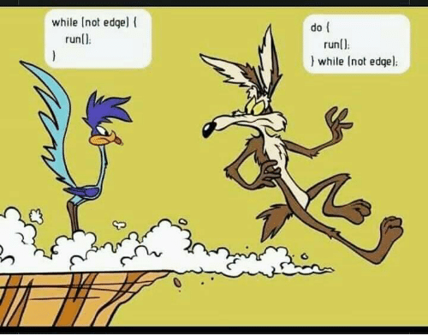
Iteration (aka Looping)

Slide 33
Looping/Iteration
What’s the big picture?
Loops come in three major forms:
Counter-controlled
for i in range(1,10):
do_something()
Condition-controlled
while (condition)
do_something()
Collection-controlled
for (x in container)
do_something(x)
Both collection-controlled (and often) counter-controlled loops rely upon iterators under the hood.
Let's see!

Slide 34
History of Iteration
Ada Lovelace, 1815-1852, was the first person to describe the concept of looping - for Babbage's Analytical Engine.
How did the first high-level language implement looping?
Thinking time!
Answer: Fortran used IF and GOTO statements to loop!
N = 10
I = 0
100 P = N - I
IF (P), 200, 200, 101
101 ... statements to run in loop
I = I + 1
GO TO 100 200 ... statements after loop
... statements after loop

Slide 35
Counter-Controlled Iteration
Perl provides an anonymous name of _ for the iteration value.
This range notation defines an object that has a method called for_each()!
We specify a lambda function with a single argument to for_each()!
Let's see how a variety of languages iterate over a range of [0,9]!
# Perl
for (0..9) {
print("$_\n");
}
// Rust
for elem in 0..10 {
println!("{}", elem);
}
// Or this:
(0..10).for_each( |elem| println!("{}", elem) );
In Ruby, numbers appear to be objects, and have an upto(n) method!
Some languages have an inclusive range [A,B] and others do not [A,B).
// Kotlin
for (elem in 0..9)
{ println("$elem") }
// Or this:
(0..9).forEach(
{ elem -> println("$elem") })
# Ruby
(0..9).each do |elem|
print elem, " "
end
# Or this:
0.upto(9)
{ |elem| print elem, " " }
# Python
for elem in range(0,10):
print(elem)
// Swift
for elem in 0...9 {
print(elem)
}
// Or this:
(0...9).forEach { elem in print(elem) }
// PHP
foreach (range(0,9) as $i) {
echo $i, " ";
}
// Go
for i := 0; i < 10; i++ { fmt.Println(i)
}
What interesting things do you notice about these approaches?
Thinking time!
Notes:
#ruby has loops with lambdas
1.upto(5) { |x| print x, " " } # { } is a lambda
list.each { | value | puts value }
3.times { |x| print x, " " } # { } is a lambda
(1..5).each do { |x| print x, " " } # { } is a lambda
// Kotlin
for (i in 1..3) {
println(i)
}
for (i in 6 downTo 0 step 2) {
println(i)
}
(1..5).forEach { println("$it") }

Slide 36
Collection-controlled Iteration
Many languages have similar to C++'s:
for (type elem: items) { ... }
Let's see how a variety of languages iterate over items in a collection!
# Perl @items = ("fee","fi","fo","fum");
foreach $elem (@items) { print "$elem\n"; }
The other approach is to use a collection.for_each({run code})
// Rust
let items = vec!["fee","fi","fo","fum"];
for elem in items { println!("{}",elem) }
// Or this:
items.iter().for_each(|elem| println!("{}", elem));
# Ruby
items = ["fee","fi","fo","fum"]
items.each do |elem|
print(elem,"\n")
end
// Swift
let items = ["fee","fi","fo","fum"]
for elem in items { print(elem); }
// Or this:
items.forEach { elem in print(elem) }
We provide for_each() with a lambda or block of code.
// Kotlin
var items = arrayOf("fee","fi","fo","fum")
for (elem in items) println(elem)
// Or this:
items.forEach({ elem -> println("$elem") })
// PHP
$items = array("fee","fi","fo","fum");
foreach ($items as $elem) { echo("$elem\n"); }
What interesting things do you notice about these approaches?
Thinking time!
Notes:
#ruby has loops with lambdas
1.upto(5) { |x| print x, " " } # { } is a lambda
list.each { | value | puts value }
3.times { |x| print x, " " } # { } is a lambda
(1..5).each do { |x| print x, " " } # { } is a lambda
// Kotlin
for (i in 1..3) {
println(i)
}
for (i in 6 downTo 0 step 2) {
println(i)
}
(1..5).forEach { println("$it") }

Slide 37
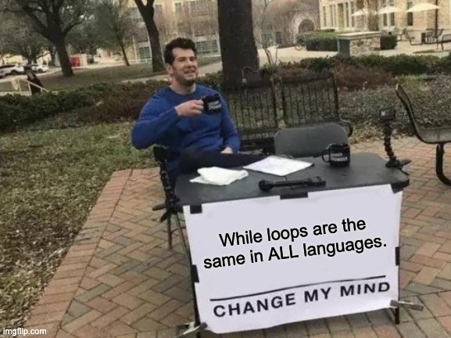
What about While/Do-While Loops?
Then we call Boolean's whileTrue method.
OK... Maybe not Smalltalk!
" Smalltalk while loop "
number := 10.
[ number > 0 ] whileTrue:
[ Transcript print: number; nl.
number := number - 1 ]
This evaluates to a Boolean...
And pass in a lambda (with no arguments) to run.
Alright, enough with basic loops – let's discuss how iteration actually works!

Slide 38
How Does Iteration Actually Work?
We just saw how languages let us use simple looping syntax to iterate through iterable objects like lists, vectors and ranges.
So how does this iteration actually work under the hood?
These kinds of loops are implemented using "iterators"
for n in student_names:
print(n)
for i in range(0,10):
print(i)
Loops like these are built using first-class functions
fruits.forEach { f -> println("$f") }
Let's dive into each of these approaches.

Slide 39



First... Iterable Objects
An iterable object is an object that holds, has access to, or can generate a sequence of values.
An iterable object can be iterated over (using an iterator) to obtain its values.
Iterable Object Categories:
Container Objects e.g., arrays, lists, tuples, sets, vectors, dictionaries
I/O Objects
i.e., an object that can be used to access a disk file or network stream
Generator Objects
e.g., objects that can generate a sequence like range(0, 10)
0, 1, 1, 2, 3, 5, 8, 13, ...
Notes:
The values are either held in separate "iterable object" or generated by a function that knows how to produce values of the requested sequence.
In most cases, the iterator is distinct from the values it is meant to enumerate.

Slide 40
And now... Iterators
An iterator is an object that enables enumeration of an iterable object's values.
An iterator provides a way to access the values of an iterable object without exposing the iterable object's underlying implementation.
An abstract sequence is one where the values in the sequence aren't stored anywhere, but generated as they're retrieved via the iterator
Iterators can be used to enumerate the values held in a container (e.g., a list, set)
Iterators can be used to enumerate external sources like data files and network streams
Iterators can be used to enumerate the values of an abstract sequence
0, 1, 1, 2, 3, 5, 8, 13, ...
iterator
iterator
iterator
Notes:
The values are either held in separate "iterable object" or generated by a function that knows how to produce values of the requested sequence.
In most cases, the iterator is distinct from the values it is meant to enumerate.

Slide 41
Iterators
Iterators used with containers and external sources are typically distinct objects from the sequences they refer to.
Why do we separate the iterator from the iterable object that actually holds the sequence?
Thinking time!
from the "iterable object" that holds the values it's meant to iterate over.
0, 1, 1, 2, 3, 5, 8, 13, ...
The iterator is separate...
iterator
iterator
iterator
Notes:
Answers:
This enables us to have multiple iterators pointing to different items in the sequence at the same time. If the container itself held the iterator, then we couldn't have multiple iterators at the same time.
This places the responsibility for traversal on the iterator object, giving it a single responsibility (iterating), and giving the container a single responsibility (holding items).

Slide 42
Iterators
To create an iterator, you must ask the "iterable object" that holds/defines your sequence to give one to you.
// Kotlin: iterator into container
val numbers = listOf(10,20,30,42)
val it = numbers.iterator()
...
// Swift: abstract sequence
var range = 1...1000000
var it = range.makeIterator()
...
// C++
vector<string> fruits = {"apple", "pear", ... };
auto it = fruits.begin();
...
0, 1, 1, 2, 3, 5, 8, 13, ...
iterator
iterator
iterator

Slide 43
Iterators
* C++ being a notable exception ☺
While iterators differ by language, most* tend to have an interface that look like one of these:
For Containers and External Sources
iter.hasNext():
Does the iterator refer to a valid value that can be retrieved?
iter.next():
Get the value pointed to by the iterator and advance the iterator to the next item
For Abstract Sequences
iter.next():
Generates and returns the next value in the sequence,
OR indicates the sequence is over via a return code/exception
// C++ has unusual iterator syntax!
vector<string> fruits = {"apple", "pear", ... };
for (auto it = fruits.begin(); it != fruits.end(); ++it)
cout << *it;
// Kotlin: iterator into container
val numbers = listOf(10,20,30,42)
val it = numbers.iterator()
while (it.hasNext()) {
val v = it.next();
println(v)
}
// Swift: abstract sequence
var range = 1...1000000
var it = range.makeIterator()
while true {
var v = it.next()
if (v == nil) { break }
print(v)
}
0, 1, 1, 2, 3, 5, 8, 13, ...
iterator
iterator
iterator

Slide 44
Iterators
Academic Robot Says:
"This is a fantastic example of Syntactic Sugar!"
When you loop over the items in an iterable object , the language secretly uses an iterator to move through the items!
// Kotlin: iterate over list of #s
val numbers = listOf(10,20,30,42)
for (v in numbers) {
println(v)
}
// Swift: iterate over range
for v in 1...1000000 {
print(v)
}
val numbers = listOf(10,20,30,42)
val it = numbers.iterator()
while (it.hasNext()) {
val v = it.next()
println(v)
}
var range = 1...1000000
var it = range.makeIterator()
while true {
var v = it.next()
if (v == nil) { break }
print(v)
}

Slide 45
How Are Iterators Implemented?
There are two primary approaches for creating iterators:
With Traditional Classes
An iterator is an object, implemented using regular OOP classes.
"True Iterators" aka Generators
An iterator is implemented by using a special type of function called a generator.
Notes:
A generator is a function that can be called repeatedly to produce a sequence of values over time.
Each time you call the function, you get the next value in the sequence.
The function can be called repeatedly to produce a sequence of values over time.

Slide 46
Iterator Objects: Python
class OurIterator:
def __init__(self, arr):
self.arr = arr
self.pos = 0
def __next__(self):
if self.pos < len(self.arr):
val = self.arr[self.pos]
self.pos += 1
return val
else:
raise StopIteration
class ListOfStrings:
def __init__(self):
self.array = []
def add(self,val):
self.array.append(val)
def __iter__(self):
it = OurIterator(self.array)
return it
To create the iterator, we need to pass in the private array it's going to iterate over.
First let's see how to implement an iterator object for a simple List class in Python.
Our iterator then initializes its position to the start of the array.
When the iterator hits the end, __next__() throws an exception.
To make a class iterable, we must define an __iter__() method that creates and returns an iterator object.
Our iterator class must have a method called __next__() that gets the value of the item pointed to by the iterator, advances the iterator, and returns the value.
Ok, first let's define our container class.
nerds = ListOfStrings()
nerds.add("Carey")
nerds.add("David")
nerds.add("Paul")
for n in nerds:
print(n)
Python uses the exception to determine when the loop is complete.
Ok, now let's see what our iterator class looks like.
Once we finish, we can use this syntax to iterate over our list!

Slide 47
Defining an Iterator Object: Java
import java.util.Iterator;
class ListOfStrings implements Iterable<String> {
private String[] array;
private int numItems = 0, maxSize = 100;
public ListOfStrings()
{ array = new String[maxSize]; }
public void add(String val)
{ array[numItems++] = val; }
@Override public Iterator<String> iterator() {
Iterator<String> it = new OurIterator();
return it;
}
class OurIterator implements Iterator<String> {
private int iteratorIndex = 0;
@Override public boolean hasNext()
{ return iteratorIndex < numItems; }
@Override public String next()
{ return array[iteratorIndex++]; }
}
}
Let’s define a container of Strings class (like a vector)!
To be iterable, it must implement Java’s Iterable interface.
Now let's see an iterator object for a simple List class in Java.
Our class will track the number of items it holds in numItems.
public void testOurList() {
ListOfStrings nerds =
new ListOfStrings();
nerds.add("Carey");
nerds.add("David");
nerds.add("Paul");
Iterator it = nerds.iterator();
while (it.hasNext()) {
String value = (String)it.next();
System.out.println(value);
}
for (String s: nerds)
System.out.println(s);
}
Alright, now let’s define our own custom Iterator class, which is specific to our ListOfStrings.
If we like, we can use the iterator notation explicitly…
Finally, let’s update our class so its user can request an iterator to the first item.
Or Java can use its syntactic sugar for us, and let us use built-in iteration syntax!
It must implement Java’s Iterator interface to be a valid iterator class.
The iterator must have some way of knowing which item it points to.
Let’s always start at the first/0th item.
Since OurIterator is a nested class, it can access the members of the outer class (ListOfStrings).
The first required method, hasNext, determines if the iterator points at a valid item that can be retrieved.
The second required method, next, returns the item pointed to by the iterator, then advances the iterator.

Slide 48
Let's Implement a Range Class in Python
As before, when we reach the end of the range, we raise an exception.
Now let's implement a Range class and its iterator!
class OurIter: # iterator class
def __init__(self, start, end):
self.cur = start
self.end = end
def __next__(self):
if self.cur < self.end:
val = self.cur
self.cur += 1
return val
else:
raise StopIteration()
class OurRange: # iterable class
def __init__(self, end):
self.end = end
def __iter__(self):
iter = OurIter(0, self.end)
return iter
Now let's see our iterator class!
for i in OurRange(5): # from [0,5)
print(i)
print("Done!")
First it saves the current value to return.
When we construct a range object, we specify the range of values it covers.
Here's our __next__() method.
First let's define our new range class. It's our "iterable" class.
Its constructor sets the current position (cur) to the start of the range, and remembers the end.
tmp = OurRange(5)
iter = tmp.__iter__()
try:
while True:
i = iter.__next__()
print(i)
except StopIteration:
pass # loop is done
print("Done!")
Here's how our range class will be used.
And then it advances to the next value in the range.
We also define an __iter__() method that can be called to get a new iterator.
Our constructor simply stores away the upper-end of the range.
Finally, here's what the syntactic sugar is hiding!

Slide 49
How Are Iterators Implemented?
With Traditional Classes
An iterator is an object, implemented using regular OOP classes.
"True Iterators" aka Generators
An iterator is implemented by using a special type of function called a generator.
Notes:
A generator is a function that can be called repeatedly to produce a sequence of values over time.
Each time you call the function, you get the next value in the sequence.
The function can be called repeatedly to produce a sequence of values over time.

Slide 50
Generator Challenge
def foo(int n):
for i in range (1, n):
print(f'i is {i}')
pause
print('woot!')
n
4
So what's a generator? Let's find out!
i
1
3
2
This pauses our function – its instruction pointer is saved along with all variables in the closure.
def foo(n):
for i in range (1, n):
print(f'i is {i}')
pause
print('woot!')
def main():
p = create_pausable(func=foo, n=4)
print('CS')
start(p)
print('is')
resume(p)
print('cool!')
resume(p)
Consider the pseudocode on the left, written in pigeon Python.
What do you think this will print?
p
Thinking time!
CS
i is 1
is
This creates a closure for our foo() function, starting it in a paused state.
woot!
This starts running our paused function.
i is 2
And our program continues executing here.
cool!
This resumes our paused function.
woot!
i is 3

Slide 51
Generators
Our foo() function is called a "generator."
A generator function can be paused and resumed, with its state (variables, instruction pointer) saved between calls!
def foo(n):
for i in range (1, n):
print(f'i is {i}')
pause
print('woot!')
def main():
p = create_pausable(func=foo, n=4)
print('CS')
start(p)
print('is')
resume(p)
print('cool!')
resume(p)
In Python, you create a generator object by simply calling the generator function with its parameters.
Let's see the real syntax in Python now.
Finally, a generator pauses itself by using the "yield" statement.
yield
We start our generator by calling Python's next() function.
Even though you're calling it like a function, this really creates an iterator/closure for the function.
p = foo(4)
We also un-pause/resume our generator with the next() function.
next(p)
next(p)
next(p)

Slide 52
Generator Challenge, Part 2
This not only pauses the generator, but outputs the specified value (e.g., a).
def bar(a, b):
while a > b:
yield a
a -= 1
f = bar(3, 0)
print('Eat prunes!')
t = next(f)
print(t)
t = next(f)
print(t)
t = next(f)
print(t)
print(f'Explosive diarrhea!')
This generator uses yield in a slightly different way.
The initial call to the generator returns an iterator, implemented using a closure.
What do you think this will print?
So every time we call next(), we're asking the iterator to generate the next value in the sequence.
Thinking time!
Eat prunes!
3
2
1
Explosive diarrhea!
The statement that called next() on the generator can then get the outputted value like this.
Each call to next() resumes the generator until we hit the next yield.
This is a more idiomatic use of a generator – they're used to "generate" a sequence of values that can be retrieved one at a time – the sequence might be finite, or infinite!

Slide 53
Looping Over Generators
Academic Robot Says:
"A generator function may be called a true iterator, but it's really an iterable object!"
def bar(a, b):
while a > b:
yield a
a -= 1
f = bar(3, 0)
print('Eat prunes!')
t = next(f)
print(t)
t = next(f)
print(t)
t = next(f)
print(t)
print(f'Explosive diarrhea!')
def our_range(a, b):
while a > b:
yield a
a -= 1
print('Eat prunes!')
for t in our_range(3,0):
print(t)
print(f'Explosive diarrhea!')
Iterable object
A generator is an iterable object!
That's LIT!
Python can automatically use the generator in a loop!
And when you call the generator, it produces an iterator!
Answer: When the generator finally exits without a yield, this signals that it's time to stop looping.
How does Python know when the loop should end?
So you can use it like any other iterable object in loops!
An iterator!
Another name for a generator function is a "true iterator."
Notes:
In Python, every generator function throws a StopIteration exception *implicitly* which indicates to Python's for loop that the end of iteration has been reached.

Slide 54
Generators in Different Languages
This is a generator that generates an infinite sequence!
// Kotlin
fun vals(start: Int) = sequence {
var i = start
while (true) {
yield(i)
++i
}
}
fun main(args: Array<String>) {
val iter = vals(42).iterator()
var count = 3
while (count-- > 0) {
var n = iter.next()
println(n)
}
for (n in vals(7).take(5))
println(n) // 7, 8, 9, 10, 11
}
// JavaScript
gen = function*(n) {
yield 'I';
yield 'want';
yield n;
yield 'cookies';
};
g = gen(10);
while (true) {
r = g.next();
if (r.done) break;
console.log(r.value);
}
for (word of gen(3)) {
console.log(word);
}
In JavaScript, we indicate a function is a generator by adding a * after the function name.
This creates an iterator for your generator (the iterator uses a closure).
In Kotlin, a generator is called a "sequence."
This resumes the generator so it runs until it reaches a yield.
r either holds a value or a status indicating the sequence is over.
Here's how we create our iterator from the generator function.
Yield works the same exact way as in Python!
Here's how we check if the sequence is over.
take(n) allows us to get only the first n values of the infinite sequence!
Here's how we use the generator in a loop.
Here's how we get the yielded value explicitly.
Here's how we get the next value.
Here's how we use the generator in a loop!
Let's see some generators in different languages.
Notes:
fun vals(start: Int) = sequence {
// this sequence is infinite
var i = start
while (true) {
yield(i)
++i
}
}
fun main(args: Array<String>) {
val fibIter = vals(42).iterator()
var count = 3
while (count-- > 0) {
var fib = fibIter.next()
println(fib)
}
// infinite loop!
for (n in vals(-10))
println(n)
}

Slide 55
Iterator Objects and Generators
Python's comprehensions are implemented using generator functions!
iter = (y*y for y in range(3,10))
What can we do with an iterator object that you can't do with a generator, and visa-versa?
Thinking time!
Why would you prefer iterating using a generator vs. iterating over a list of the same size?
for i in range(1,10000000):
print(i)
if some_condition(i) == True:
break
lst = [1, 2, 3,..., 10000000]
for i in lst:
print(i)
if some_condition(i) == True:
break
Thinking time!
Notes:
What can you do with an iterator that you can't do with a generator? The two are functionally equivalent in most instances. Some iterators, like in C++, can move both forward and backward, which obviously can't be done with a generator. But otherwise, you can accomplish tasks with either approach (with more or less effort).
Creating a list of 10M items takes a huge amount of memory. A generator takes next to no memory, and can produce the same sequence of numbers. In fact, it can produce an infinite sequence of numbers. So if you're just iterating over a bunch of numbers, its faster and smaller to use a generator rather than creating a full list.

Slide 56
How Does Iteration Actually Work?
Alright, enough of iterators!
Let's see how to iterate with first-class functions.
These kinds of loops are implemented using "iterators"
for n in student_names:
print(n)
for i in range(0,10):
print(i)
Loops like these are built using first-class functions
fruits.forEach { f -> println("$f") }

Slide 57
Iteration with First Class Functions
Ruby's syntax is a bit weird... But while this looks like a block, it's the same as a lambda!
Earlier we saw the following type of looping syntax:
// Rust
(0..10).for_each(|elem| println!("{}", elem));
let items = vec!["fee","fi","fo","fum"];
items.iter().for_each(|elem| println!("{}", elem));
# Ruby
(0..9).each do |elem|
print elem, " "
end
In many languages, an iterable object will have a forEach() or each() method.
The method will apply the passed-in function to each of the iterable's values.
// Kotlin
(0..9).forEach({ elem -> println("$elem") })
items = ["fee","fi","fo","fum"]
items.each do |elem|
print(elem,"\n")
end
var items = arrayOf("fee","fi","fo","fum")
items.forEach({ elem -> println("$elem") })
With this syntax, we're NOT using an iterator!
// Swift
(0...9).forEach
{ elem in print(elem) }
Instead, we're passing a function as an argument to a forEach()/each() method that loops over the iterable's items!
let items = ["fee","fi","fo","fum"]
items.forEach { elem in print(elem) }

Slide 58
Iteration with First Class Functions
Let's build a forEach() method for our earlier Python container:
class ListOfStrings:
def __init__(self):
self.array = []
def add(self,val):
self.array.append(val)
def forEach(self, f):
for x in self.array:
f(x)
yummy = ListOfStrings()
... # add items to yummy
def like(x):
print(f'I like {x}'))
yummy.forEach(like)
class ListOfStrings:
def __init__(self):
self.array = []
def add(self,val):
self.array.append(val)
def forEach(self, f):
for x in self.array:
f(x)
yummy = ListOfStrings()
yummy.add('bindi masala')
yummy.add('koobideh')
yummy.add('gai lan')
yummy.forEach(lambda food: print(f'I like {food}'))
As you can see, an iterator is not used for this syntax!
Basically, the forEach() method enumerates all of the items itself...
Instead, the iterable object iterates over its own items, and calls the provided f().
and passes each item to the provided function.
This is essentially a map() operation like we saw in functional programming!
Of course, we don't need to pass a lambda – we can also pass a regular function.

Slide 59
Iterating With First-class Functions
What are the pros/cons of using forEach() + a first-class function vs. an iterator?
What happens if you delete an item from a container while you're iterating over its items using any of the approaches?
Thinking time!
Notes:
Using a first-class function is equivalent to the iterator approaches we saw. You can run some logic on each element in a sequence (item in a container, or value in a range).
In general, deleting an item from a container during iteration is considered a bad idea, because different types of containers have different semantics when you delete an item. So it's best to be super careful when deleting items during iteration (make sure you document why it's legal), or avoid the practice all together.

Slide 60
Classify That Language: Iterators
In the class to the left, we have created a container class that supports iteration.
class Kontainer implements Iterator {
private $array = array();
public function add($val)
{ array_push($this->array,$val); }
private $pos = 0;
public function rewind() { $this->pos = 0; }
public function current()
{ return $this->array[$this->pos]; }
public function key() { return $this->pos; }
public function next() { ++$this->pos; }
public function valid()
{ return $this->pos < count($this->array); }
}
Will this class support nested loops?
If so, why? If not, why not?
$letters = new Kontainer;
$letters->add("a");
$letters->add("b");
$letters->add("c");
foreach($items as $i) {
foreach($items as $j) {
print( $i . " " . $j . ", ");
}
}
This is PHP!
Thinking time!
Notes:
Answer: This class CANNOT support nested loops. Why? A Kontainer object only contains a single position (pos) that points into the container for iteration. When we run the inner foreach loop, that will iterate until we reach the end of the container's items, setting pos = length(this->array). When we start the second iteration of the outer loop, our position will already be at the end of the array, and the loop will immediately terminate. If we wanted to support nested loops like this, we'd have to create separate iterator objects, and have our Kontainer return a new iterator each time getIterator() call is made. See: https://www.howtogeek.com/devops/how-to-write-your-own-iterable-objects-in-php/

Slide 61
That's It!
Hopefully, you now have a good overview of how expression evaluation and flow control work across programming languages!
And now... onto Prolog!

Slide 62
Slide Graveyard/Appendix

Slide 63
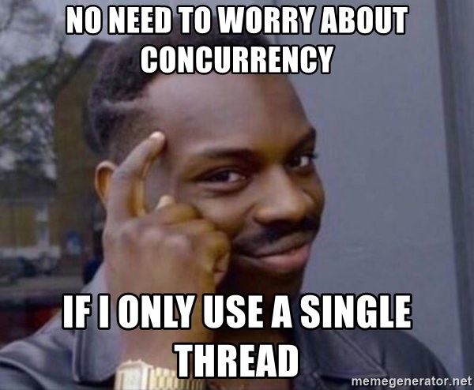
Concurrency
Many modern programming languages have explicit support for concurrent execution (running multiple things at once).
This is a huge domain, so we'll just do a quick survey of a few relevant areas.

Slide 64
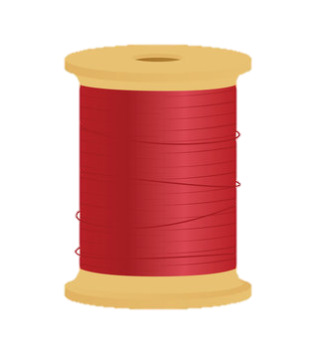
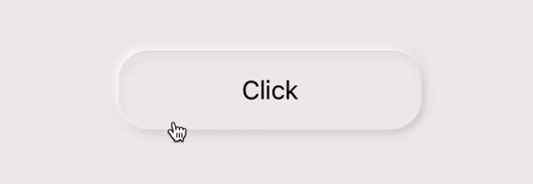
Concurrency
Concurrency is a paradigm in which a program is decomposed into simultaneously executing tasks.
Those tasks might...
Run in parallel on multiple cores
Run multiplexed on a single core
Operate on totally independent data
e.g., each sorting a different array
Operate on shared mutable data or systems
e.g., two tasks modifying a shared queue
3 | 5 | 2 | 9 | 4
1 | 0 | 7 | 19 | -5
queue
Be launched deterministically as part of the regular flow of a program
Be launched due to an external event occurring, like a click of a button in a UI
def solve_a_problem():
a = run_concurrently task1()
b = run_concurrently task2()
use_results_when_done(a,b)

Slide 65
Concurrency
Concurrency can make our programs more efficient!
The old way: Serial Execution
def slide_show(url1, url2, url3):
photos = []
dl_photo(url1, photos)
dl_photo(url2, photos)
dl_photo(url3, photos)
display(photos)
dl_photo()
dl_photo()
dl_photo()
display()
By the way, this is pseudocode – not correct syntax!
The concurrently-running tasks could run in parallel like this...
Or in a single thread, like this.
The new way: Concurrent Execution
def slide_show(url1, url2, url3):
photos = []
a = run_concurrently dload_photo(url1, photos)
b = run_concurrently dload_photo(url2, photos)
c = run_concurrently dload_photo(url3, photos)
wait_for_all_to_complete(a,b,c)
display(photos)
url2
finished
dl_photo()
url3
finished
dl_photo()
dl_photo()
display()
url1
finished
wait_for_all_to_complete()
display()
Notes:
Concurrency is when the execution of multiple tasks is interleaved, instead of each task being executed sequentially one after another.
Concurrency is the approach of executing different parts of a program out-of-order (possibly in parallel), to yield the same result more efficiently than serial execution.
Concurrency is the execution of the multiple instruction sequences at the same time.
Concurrency is the execution of multiple computations simultaneously
Concurrency is a software structuring technique that allows us to
model computations as hypothetical independent activities (e.g. with their own
program counters) that can communicate and synchronize.
A concurrent program: It is a program that has
multiple threads or tasks of control allowing it perform
multiple computations in parallel and to control multiple
external activities that occur at the same time.

Slide 66
Concurrency
If a concurrent program only runs on a single core, why would it be any faster than a program that runs serially?
Thinking time!
request initiated
waiting for server
Answer: Some tasks involve lots of waiting, but make little use of the CPU!
saving file
dl_photo()
dl_photo()
dl_photo()
display()
Consider downloading a photo!
90% or more of the time might be waiting for the server to send the file!
request initiated
20% of file recvd
During that waiting time, a concurrent program can use the CPU for other useful tasks!
url2
finished
Rest received; saving file
url3
finished
display()
more waiting time
url1
finished
waiting time

Slide 67
Concurrency
karma would be an example of a mutable variable that's shared between multiple threads.
Academic Robot Says:
This thread could be paused right here to run our other thread.
"A key goal of concurrency is determinism: ensuring that code produces the same result every time it runs (regardless of how its tasks are scheduled)!"
Getting concurrency right is challenging!
register1
0
1
// karma++ in assembly:
mov register1, [karma]
inc register1
mov [karma], register1
What will the value of karma be if I run both functions concurrently until completion? Why?
int karma = 0;
void do_good_deeds() {
for (int i=0;i<100000;++i)
karma++;
}
void be_naughty() {
for (int i=0;i<100000;++i)
karma--;
}
...
Our good karma thread completely overwrites the change made by the bad karma thread!
Answer: Given that each "thread" of execution can be interrupted at any time to run the other, it's impossible to know!
Thinking time!
karma
???
0
1
-1
-2
-3
-4
-5
-6
-7
-8
-9
Any time two threads of execution use "shared mutable state", this kind of thing can happen.
We might then pause again here, to run our other thread.
This is called a "race condition."
Notes:
Race Condition: A race condition or race hazard is the condition of an electronics, software, or other system where the system's substantive behavior is dependent on the sequence or timing of other uncontrollable events. It becomes a bug when one or more of the possible behaviors is undesirable.

Slide 68
Concurrency With Shared Mutable State
class Karma extends Thread {
private static int karma = 0
static void do_good_deeds() {
for (int i=0;i<100000;++i)
synchronized(Karma.class) { karma++; }
}
static void be_naughty() {
for (int i=0;i<100000;++i)
synchronized(Karma.class) { karma--; }
}
public static void main(String args[]) {
... // Code to start two threads and run
... // do_good_deeds() and be_naughty()
System.out.println(karma);
}
}
Most modern languages now have built-in language features to make it safer to use shared mutable state.
For example, Java's synchronized keyword can be used to limit access to a mutable variable to a single thread at a time.
The synchronized keyword ensures that only one of these two blocks can run at a time.
We won't be covering these features in any detail, but it's good to know they exist.
But be careful – it's still difficult to get shared mutable state right (and efficient)!

Slide 69
Models for Concurrency
Academic Robot Says:
"Don't forget to mention there are hybrids, Carey!"
There are two primary approaches for implementing concurrency:
Multi-threading Model
A program creates multiple "threads" of execution that run concurrently (potentially in parallel).
The programmer explicitly "launches" one or more functions in their own threads, and the OS schedules their execution across available CPU cores.
Event Driven Model
A program consists of a queue of functions to run, and an infinite loop that dequeues and runs each function from the queue, one after the other.
When an event occurs (e.g., user clicks a button) the event results in a new function f() being added to the queue which eventually runs and handles the event.
// Multi-threaded program (pseudocode)
void handle_user_purchase(User u, Item i) {
if (bill_credit_card(u) == SUCCESS) {
create_thread(schedule_shipping(u, i));
create_thread(send_confirm_email(u, i));
}
}
// Event-driven program (pseudocode)
function process_payment() { ... }
void setup_event_associations() {
button = create_new_button("Pay Now!");
button.set_func(ON_CLICK, process_payment);
}
Notes:
Hybrids: You can launch background threads in event-driven systems, for example.

Slide 70
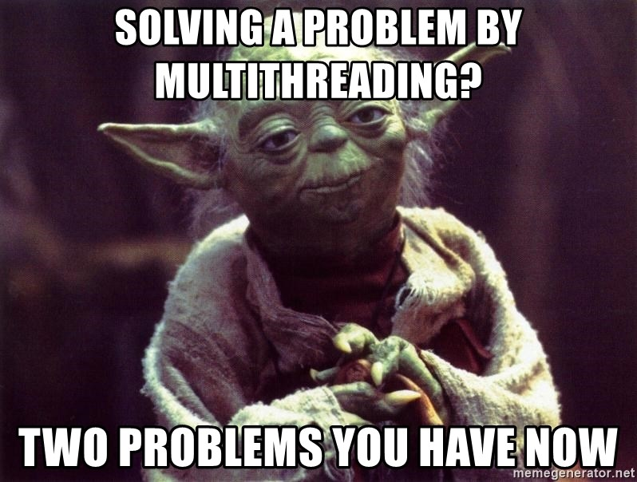
Multi-Threading

Slide 71
Fork-Join: A Common Pattern for Multi-Threading
Process part 1 in parallel
The "fork-join" pattern is basically a concurrent version of divide and conquer.
Fork
(Split task into N disjoint parts)
Serial Task
Process part 2 in parallel
Join
(Combine parts)
Serial Task
A parallel sort would be a good example of a problem suitable for fork-join.
...
Process part n in parallel
First, we "fork" one or more tasks so they execute concurrently...
Second, we wait for all those tasks to complete (aka "join") and then proceed.
function sort_in_parallel(array, n) {
t1 = run_background(sort(array[0:n/3]));
t2 = run_background(sort(array[n/3:n*2/3));
t3 = run_background(sort(array[n*2/3:n]));
wait_for_all_tasks_to_finish(t1, t2, t3);
merge_sorted_subarrays(array);
}
function task1(param) { ... }
function task2(param) { ... }
function task3(param1, param2) { ... }
function launch_in_parallel() {
t1 = run_background(task1(42));
t2 = run_background(task2("suss"));
t3 = run_background(task3(3.14, 2.71));
wait_for_all_tasks_to_finish(t1, t2, t3);
print("All tasks completed, proceeding...");
}
So other tasks can run in this computational void.
task3
Generally, waiting doesn't actually take any CPU processing power...
task2
task1

Slide 72
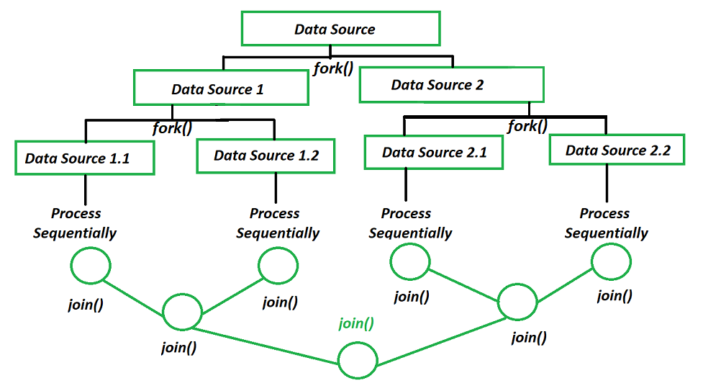
Fork-Join is Often Used Recursively
Source: GeeksForGeeks

Slide 73
Fork-Join In Different Languages
The lambda function then calls our desired task function with the proper arguments, and then gets the result.
// C++
#include <thread>
void task1(int n) { ... }
void task2(int n) { ... }
void task3(int n) { ... }
int main() {
std::cout << "Forking threads!\n";
std::thread t1(task1, 10);
std::thread t2(task2, 20);
std::thread t3(task3, 30);
// do other processing here...
t1.join();
t2.join();
t3.join();
std::cout << "All threads joined!\n";
}
// C#
using System;
using System.Threading;
using System.Threading.Tasks;
class Program {
static int task1(int param) { ... }
static int task2(int param) { ... }
static int task3(int param) { ... }
public static void Main(string[] args) {
int r1 = 0, r2 = 0, r3 = 0;
Console.WriteLine("Forking threads!");
var t1 = Task.Run(() => r1 = task1(10));
var t2 = Task.Run(() => r2 = task2(20));
var t3 = Task.Run(() => r3 = task3(30));
Task.WaitAll(t1, t2, t3);
Console.WriteLine("Joined: {0}, {1}, {2}",
r1, r2, r3);
}
}
We could have done a similar thing here to get the results if we liked.
To launch a function in the background, we simply create a new thread object.
To fork, we use task.Run() to run the passed-in lambda function.
Finally, since we stored the result of our tasks in local variables...
We use Task.WaitAll() to join multiple tasks at once.
To join, we simple call the thread.join() method. This blocks the caller until the thread finishes.
We can use the output after we join the results.
Notes:
Here's go:
//Go https://www.digitalocean.com/community/tutorials/how-to-run-multiple-functions-concurrently-in-go
package main
import (
"fmt"
"sync"
)
// 4
func printer(msg string, wg *sync.WaitGroup) {
defer wg.Done()
fmt.Printf("Hello %s\n", msg)
}
func main() {
// 1
greeks := []string{"plato", "socrates", "aristotle", "archimedes", "pythagoras", "democritus"}
// 2
var wg sync.WaitGroup
fmt.Println("Init")
for _, philosopher := range greeks {
// 3
wg.Add(1)
go printer(philosopher, &wg)
}
// 5
wg.Wait()
fmt.Println("End")
}

Slide 74
Fork-Join In Different Languages: Python
# Python
import threading
def task(n):
while n > 0: # do some computation
n = n - 1
print("Forking threads!")
t1 = threading.Thread(target=task, args=(100000000,))
t2 = threading.Thread(target=task, args=(100000000,))
t3 = threading.Thread(target=task, args=(100000000,))
t1.start()
t2.start()
t3.start()
# do other processing here...
t1.join()
t2.join()
t3.join()
print("All threads joined!")
Assuming looping 100 million times takes 5s, how long will this program take to run on a multicore PC?
Arguments to a task are passed in via a tuple.
Thinking time!
We'd expect all three tasks to run in parallel... taking 5s total. But it takes 15s!
Why? Because when each Python thread runs, it claims exclusive access to Python's memory/objects.
In Python, we must create a thread object, and then do thread.start() before it runs.
So only one thread generally does computation at a time!
And here's how we join.
Notes:
Why the extra comma in the tuples: args = (1000000000,)? Because if we just use parentheses and a number, e.g., args = (100000) then Python can't tell this is a tuple, and things its a regular numeric expression. So adding a trailing comma before the closing parenthesis tells Python this is indeed a tuple.

Slide 75

Fork-Join In Different Languages: Python
# Python
import threading
def task(n):
while n > 0:
n = n - 1
print("Forking threads!")
t1 = threading.Thread(target=task, args=(100000000,))
t2 = threading.Thread(target=task, args=(100000000,))
t3 = threading.Thread(target=task, args=(100000000,))
t1.start()
t2.start()
t3.start()
# do other processing here...
t1.join()
t2.join()
t3.join()
print("All threads joined!")
Why? Python's garbage collection system was never designed to be thread-safe!
So, what's going on?
Python has something called a "Global Interpreter Lock" or GIL.
The GIL is like a hot potato – it can only have one owner at a time.
Once a thread takes ownership of the GIL it's allowed to read/write to Python objects.
After a thread runs for a while, it releases the GIL (tosses the potato) to another thread and gives it ownership.
If a thread is waiting for the GIL, it simply falls asleep until it gets its turn.

Slide 76
Fork-Join In Different Languages: Python
Academic Robot Says:
"In addition to I/O ops, many external C++ libraries (e.g., pytorch) have operations that can also run in parallel!"
# Python
import threading
def task(n):
while n > 0:
n = n - 1
print("Forking threads!")
t1 = threading.Thread(target=task, args=(100000000,))
t2 = threading.Thread(target=task, args=(100000000,))
t3 = threading.Thread(target=task, args=(100000000,))
t1.start()
t2.start()
t3.start()
# do other processing here...
t1.join()
t2.join()
t3.join()
print("All threads joined!")
# Python
import threading
def task(symbol):
response = urllib2.urlopen('www.stocks.com/'+symbol)
html = response.read()
print("Forking threads!")
t1 = threading.Thread(target=task, args=("goog",))
t2 = threading.Thread(target=task, args=("amzn",))
t3 = threading.Thread(target=task, args=("bby",))
t1.start()
t2.start()
t3.start()
# do other processing here...
t1.join()
t2.join()
t3.join()
print("All threads joined!")
So why even support multiple threads? Are there any cases where multithreading speeds things up?
Thinking time!
Answer: I/O operations like downloading data from the web or saving a file to disk DON'T need the GIL to run!
So these kinds of operations can still make progress if launched in the background!

Slide 77

UI Programming and Concurrency
When we're building user interfaces, concurrency works a bit differently.
It might be surprising, but most UIs (Windows, MAC, iPhone, Android, browsers) are single-threaded and "event-based"!
Let's see how event-based concurrency works next!

Slide 78
But First... Callback Functions
A callback function is a function that is called when an "event" occurs.
The event could be a click of a UI button, a timer expiring, or a completed payment transaction.
The callback performs a follow-up action that handles the just-completed event.
This says: "Call the call_upon_click() function if/when the user clicks the payment button.
function set_up_ui() {
payment_button = new Button("Pay now!");
payment_button.set_callback(ON_CLICK, call_upon_click);
add_button_to_ui(payment_button);
}
function call_upon_click() {
pay_obj = new PaymentProcessor();
pay_obj.set_callback(call_upon_payment_done);
pay_obj.initiate_payment_in_background();
}
function call_upon_payment_done(result) {
if (result == SUCCESS) update_ui("Payment accepted!");
else update_ui("Card denied!");
}
This launches our task in the background.
(this is pseudo-syntax)
And instructs it to call this callback when it eventually completes.
For example, a callback handling a button click could initiate a credit-card purchase...
Our task is done, so it runs the callback, then terminates.
and the callback that's triggered when the purchase completes would update the webpage with the payment result.
Our main UI code continues normally.
This initiates the payment in the background... It might take a while...

Slide 79
A Simple Web Page
It defines a text field where we'll show our fortune.
<html>
<body>
<h1>Fortune Teller</h1>
<p id="fort">What does the future hold?</p>
<button onclick="callbk();">Get Fortune</button>
<script>
set_background_color(BLACK);
play_mp3("spooky_music.mp3");
function callbk() {
set_element("fort", "You'll ace CS131!");
}
</script>
</body>
</html>
Consider this webpage written in pseudo HTML and JavaScript.
It provides a button for the user to click to get their fortune.
This specifies a "handler" or "callback" function for our button.
This page also has top-level statements that run when the page initially loads.
The "handler" function is executed when the button is clicked.
In this example, our handler updates the "fort" field with the user's fortune.

Slide 80
Web Browser in a Slide
class Browser:
While traditional programs run from top-to-bottom, programs with UIs use a different model.
Why? UIs contain elements (e.g., buttons, sliders) that the user can interact with in any order!
So UIs use something called an Event Loop to control their execution.
Let's look at a high-level model for a web browser to see how the Event Loop works.
Notes:
For a diagram of how the browser and event loop work, see this URL: https://vahid.blog/post/2021-03-21-understanding-the-javascript-runtime-environment-and-dom-nodes/?fbclid=IwAR2di0Wq5ZoZzwCklrQO3I5i-GBwp4ZlMST6XrnVJtCrftv3nkXEA9pwqj0

Slide 81
Web Browser in a Slide
The browser keeps track of anything in the UI that can be interacted with by the user.
class Browser:
def __init__(self, page):
self.objs_on_page = self.get_all_objs(page)
self.run_queue = self.extract_stmts(page)
The browser manages two sets of items:
The browser starts by queuing up all of the top-level statements on the webpage for execution.
<html>
<body>
<h1>Fortune Teller</h1>
<p id="fort">What does the future hold?</p>
<button onclick="callbk();">Get Fortune</button>
<script>
set_background_color(BLACK);
play_mp3("spooky_music.mp3");
function callbk() {
set_element("fort", "You'll ace CS131!");
}
</script>
</body>
</html>
It manages all the objects on a page (e.g., buttons, sliders, etc.).
objs_on_page
Button
text = "Get Fortune"
onclick = callbk()
...
It maintains a queue of statements to execute from the page.
run_queue
set_background_color(BLACK);
play_mp3("spooky_music.mp3");

Slide 82
Web Browser in a Slide
class Browser:
def __init__(self, page):
self.objs_on_page = self.get_all_objs(page)
self.run_queue = self.extract_stmts(page)
def event_loop(self):
while True:
self.handle_events()
self.run_next_statement()
Now let's see our event loop – it runs an infinite loop that does two things.
First, it checks to see if the user interacted with the page's elements, and if so, deals with this.
Second, it gets the next statement from the queue (if there are any) and runs it.
The loop runs over and over, handling events, and running the next queued statement...

Slide 83
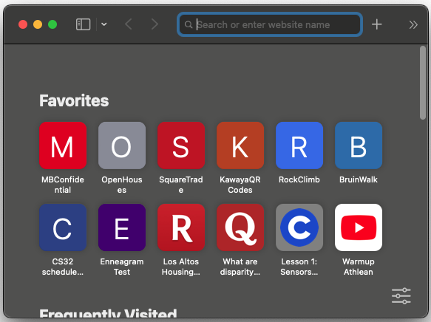
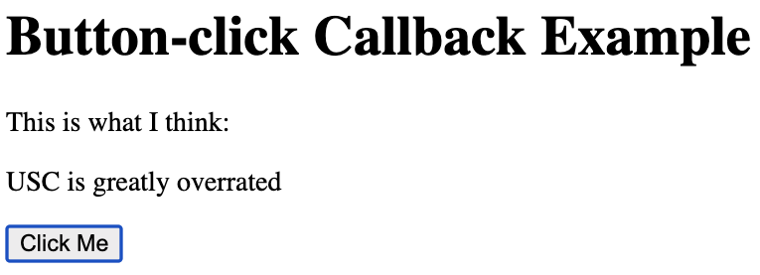
Web Browser in a Slide
...
<button onclick="callbk();">Get Fortune</button>
<script>
set_background_color(BLACK);
play_mp3("spooky_music.mp3");
function callbk() {
set_element("fort", "You'll ace CS131!");
}
</script>
...
class Browser:
def __init__(self, page):
self.objs_on_page = self.get_all_objs(page)
self.run_queue = self.extract_stmts(page)
def event_loop(self):
while True:
self.handle_events()
self.run_next_statement()
def handle_events(self):
for obj in self.objs_on_page:
if obj.event_occurred():
func = obj.get_handler()
self.run_queue.append(func)
How do we handle user-interaction events?
We cycle through each of the UI elements on the screen to see if any have been interacted with...
If an element has experienced an event (e.g., a click)...
we ask it for its handler (aka callback) function...
But we DON'T call the handler immediately!!!
Instead, we queue the function up for later execution!
run_queue
www.fortunetell.com
set_background_color(BLACK);
Fortune Teller
What does the future hold?
play_mp3("spooky_music.mp3");
callbk();

Slide 84
Web Browser in a Slide
class Browser:
def __init__(self, page):
self.objs_on_page = self.get_all_objs(page)
self.run_queue = self.extract_stmts(page)
def event_loop(self):
while True:
self.handle_events()
self.run_next_statement()
def handle_events(self):
for obj in self.objs_on_page:
if obj.event_occurred():
func = obj.get_handler()
self.run_queue.append(func)
def run_next_statement(self):
if len(self.run_queue) > 0:
func = self.dequeue()
func()
www.fortunetell.com
Finally, let's see how we run statements.
Fortune Teller
What does the future hold?
Fortune Teller
What does the future hold?
We just check to see if the queue has pending statements to run...
And if so, we dequeue the next statement and run it to completion!
run_queue
set_background_color(BLACK);
play_mp3("spooky_music.mp3");
callbk();

Slide 85
Web Browser in a Slide
class Browser:
def __init__(self, page):
self.objs_on_page = self.get_all_objs(page)
self.run_queue = self.extract_stmts(page)
def event_loop(self):
while True:
self.handle_events()
self.run_next_statement()
def handle_events(self):
for obj in self.objs_on_page:
if obj.event_occurred():
func = obj.get_handler()
self.run_queue.append(func)
def run_next_statement(self):
if len(self.run_queue) > 0:
func = self.dequeue()
func()
The Event Loop runs over and over...
Checking for new events...
Potentially adding items to the run queue...
Then running the next item in the run queue until completion...
Notes:
for (let i = 0; i < 10; i++) {
setTimeout(() => {
console.log(i)
}, 1000)
}

Slide 86
Web Browser in a Slide
class Browser:
def __init__(self, page):
self.objs_on_page = self.get_all_objs(page)
self.run_queue = self.extract_stmts(page)
def event_loop(self):
while True:
self.handle_events()
self.run_next_statement()
def handle_events(self):
for obj in self.objs_on_page:
if obj.event_occurred():
func = obj.get_handler()
self.run_queue.append(func)
def run_next_statement(self):
if len(self.run_queue) > 0:
func = self.dequeue()
func()
But wait, does ALL browser activity run in the event loop?
I/O is also tracked by the event handler just like UI events!
OK, maybe I oversimplified.
By default, all user-supplied UI code (e.g., javascript) DOES run on the event loop...
But things like I/O (e.g., downloading data, querying a DB) DO run on background threads!
In addition, you can also launch your own background threads, but there are caveats.
Database query
When they finish, the event handler queues up a callback to run on the main thread.
Download of data

Slide 87

Event Loops, Callbacks and I/O: Example
<html><body>
<div>The current weather is:</div>
<div id="weather">No weather data</div>
<script>
function update_weather_in_ui()
{ /* code to update the weather field */ }
function download_weather() {
var req = new WebRequest();
req.callback_on_completion = update_weather_in_ui;
req.set_url("https://www.weather.com/...");
req.launch_in_background();
}
download_weather();
set_background_color(BLUE);
</script>
</body></html>
www.weather.com
The current weather is:
No weather data
The current weather is:
72 and cloudy
The current weather is:
No weather data
A few seconds later, our web request finishes and the event triggers.
We then add our callback function to the run queue.
objs_on_page
We then dequeue the next function call and run it to completion.
We then dequeue the next function call and run it to completion.
We start by dequeuing the first function call and running it to completion.
XTMLHttpRequest
on_completion = update_weather_in_ui()
This launches the web request in the background and registers it as a tracked object for the page.
run_queue
Our function continues running immediately...
When the page is first loaded, all of the top-level statements are added to the run queue.
download_weather();
update_weather_in_ui();
set_background_color(BLUE);
Notes:
The code on the slide is pseudocode. Here's some actual Javascript code that largely does the same thing:
<html><body>
<div>The current weather is:</div>
<div id="weather">No weather data</div>
<script>
function update_weather_text(txt)
{ document.getElementById("weather").innerHTML = txt; }
function update_ui_when_data_arrives()
{ update_weather_text(this.responseText); }
function download_weather() {
var req = new XMLHttpRequest();
req.onreadystatechange = update_ui_when_data_arrives;
req.open("GET", "https://www.weather.com/...", true);
req.send();
}
download_weather()
</script>
</body></html>

Slide 88

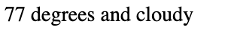

Event Loop Challenge
class Browser:
def __init__(self, page):
self.objs_on_page = self.get_all_objs(page)
self.run_queue = self.extract_stmts(page)
def event_loop(self):
while True:
self.handle_events();
self.run_next_statement();
def handle_events(self):
for obj in self.objs_on_page:
if obj.event_occurred():
func = obj.get_handler()
self.run_queue.append(func)
def run_next_statement(self):
if len(self.run_queue) > 0:
func = self.dequeue()
func()
The event handler can't run and process UI events like clicks, etc.
What happens if one of the statements in the run queue is "CPU bound" and takes a long time to run?
run_queue
run_billion_iteration_loop();
handle_button_click();
The event-loop can only do one thing at a time, so if a function (or any of the functions it calls) takes a long time to run...
Thinking time!
www.weather.com
This causes the UI to hang and become unresponsive to clicks, etc.

Slide 89

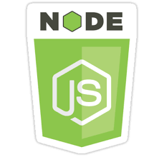
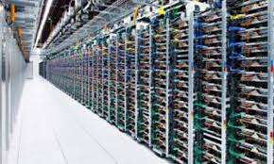


Event Loops are Everywhere
Mobile App Frameworks
Backend Frameworks
Industrial Robotics
Even the Mars Rover!

Slide 90
Event Loops and Sequences of Callbacks
<html><body>
<div>The current weather is:</div>
<div id="weather">No weather data</div>
<script>
function update_weather_in_ui()
{ /* code to update the weather field */ }
function download_weather() {
var req = new WebRequest();
req.callback_on_completion = update_weather_in_ui;
req.set_url("https://www.weather.com/...");
req.launch_in_background();
}
download_weather();
set_background_color(BLUE);
</script>
</body></html>
In this example, we saw how to run a long-running op in the background...
And use a callback upon completion to perform the next processing step.
While sometimes we'll just need to run a single background op...
In many cases, we want to chain multiple long-running background ops together into a pipeline.
This lets us accomplish more complex tasks in the background.
Notes:
for (let i = 0; i < 10; i++) {
setTimeout(() => {
console.log(i)
}, 1000)
}

Slide 91
Chaining Background Ops Together
Let's say we want to download some data, then filter the data, then sort the data, then update the UI.
We'd like to perform these tasks in the background, while the event loop lets the user interact with the UI...
DOWNLOAD
FILTER
SORT
UI
PLOT
To make this happen, we provide each phase of the pipeline with a callback function that indicates the next function to run.
And once it finishes, it adds its callback function to the run queue.
Each stage of the pipeline runs its task in the background...
And once it finishes, it adds its callback function (specifying the next task in the chain) to the run queue.
That stage runs its task in the background...
And once it finishes, it adds its callback function to the run queue.
The second-to-last stage runs its task in the background...
function launch_download(url, callback) {
run_in_background {
download_from_url(url);
add_to_run_queue(callback);
}
}
function launch_filter(data, callback) {
run_in_background {
filter_data(data);
add_to_run_queue(callback);
}
}
function launch_sort(data, callback) {
run_in_background {
sort_data(data);
add_to_run_queue(callback);
}
}
Notes:
function download_data(url) {
run_in_background((url) => {
// code to connect and download data from URL
run_in_background((data) => {
// code to filter data
run_in_background((filtered_data) => {
// code to update the UI
})
})
})
}

Slide 92

Chaining (With Callbacks) Can Get Ugly
Once we finish downloading the data...
Without going into detail, the syntax to chain multiple background functions together with callbacks is pretty ugly and requires the use of lambda functions...
function display_sorted_filtered_data(url) {
launch_download(
url,
lambda (data) {
launch_filter(
data,
lambda (fdata) {
launch_sort(
fdata,
lambda (sdata) {
display_in_ui(sdata);
}
);
}
);
}
);
}
Once we finish filtering the data...
We run a callback that sorts the data...
Once we finish sorting the data...
We run a callback that displays the data...
We run a callback that filters the data...
This nesting syntax gets so ugly that it's been given a few names including...
Callback Hell and The Pyramid of DOOM!
Notes:
function download_data(url) {
run_in_background((url) => {
// code to connect and download data from URL
run_in_background((data) => {
// code to filter data
run_in_background((filtered_data) => {
// code to update the UI
})
})
})
}

Slide 93
Promises: A Cleaner Syntax for Chaining Operations
In our previous example, we first download a file, and then filter the data, and then sort the remaining data, and then plot the data in the UI.
For this to work, each of our functions must be rewritten to use Promise objects.
Once the data has finished downloading...
Once the data has finished filtering...
Wouldn't it be nice if we could use a simpler syntax than callbacks? How about this?
function display_sorted_filtered_data(url) {
download_data(url)
.then(lambda (downloaded_data) { filter_data(downloaded_data); } )
.then(lambda (filtered_data) { sort_data(filtered_data); } )
.then(lambda (sorted_data) { update_ui(sorted_data); } )
}
function display_sorted_filtered_data(url) {
download_data(url)
.then(lambda (downloaded_data) { filter_data(downloaded_data); } )
.then(lambda (filtered_data) { sort_data(filtered_data); } )
.then(lambda (sorted_data) { update_ui(sorted_data); } )
}
This says: Add this lambda function (which is a callback) to the run queue...
This chunk of code defines a pipeline of operations.
This says: Add this lambda function to the run queue...
Each phase of the "pipeline" does its work, produces a result, and passes that result to the next lambda in the pipeline.
DOWNLOAD
FILTER
SORT
UI
PLOT
This syntax hides what's really going on – it's really just using callbacks like before!

Slide 94
Promises: A Cleaner Syntax for Chaining Operations
This chunk of code defines a pipeline of operations.
Execution of the pipeline happens concurrently!
When you create a pipeline like this, it doesn't run synchronously... it runs concurrently!
function display_sorted_filtered_data(url) {
download_data(url)
.then(lambda (downloaded_data) { filter_data(downloaded_data); } )
.then(lambda (filtered_data) { sort_data(filtered_data); } )
.then(lambda (sorted_data) { update_ui(sorted_data); } )
}
do_first_thing();
display_sorted_filtered_data("www.weather.com/...);
while (!done) {
do_other_stuff();
do_even_more_stuff();
}
function download_data(url){
while (!done) {
get_data()
save_data()
}
return result;
}
function filter_data(data) {
while (!done) {
foo();
bar();
}
return result;
}
Execution continues instantly on the next line.
This pipeline won't run to completion here! It's just started here, and runs in the background.
function sort_data(data) {
while (!done) {
divide();
conquer();
}
return result;
}
function update_ui(data) {
...
}
There's a lot of detail that we're skipping, but the important thing is to be able to recognize "Promise" syntax and know what's going on.

Slide 95
Promises and Errors
If this step of the pipeline generates an error...
If this step of the pipeline generates an error...
OK, how do we deal with errors that occur in our pipeline?
To do so, we use an "exception-like" syntax – but it's not exceptions!
function display_sorted_filtered_data(url) {
download_data(url)
.then(lambda (downloaded_data) { filter_data(downloaded_data); } )
.then(lambda (filtered_data) { sort_data(filtered_data); } )
.then(lambda (sorted_data) { update_ui(sorted_data); } )
.catch(lambda (error) { address_all_errors(error); } )
}
function display_sorted_filtered_data(url) {
download_data(url)
.then(lambda (downloaded_data) { filter_data(downloaded_data); } )
.then(lambda (filtered_data) { sort_data(filtered_data); } )
.then(lambda (sorted_data) { update_ui(sorted_data); } )
}
function display_sorted_filtered_data(url) {
download_data(url)
.then(lambda (downloaded_data) { filter_data(downloaded_data); } )
.then(lambda (filtered_data) { sort_data(filtered_data); } )
.then(lambda (sorted_data) { update_ui(sorted_data); } )
}
.catch(lambda (error) { deal_with_dl_error(error); } )
.catch(lambda (error) { deal_with_filter_error(error); } )
.catch(lambda (error) { deal_with_sorting_error(error);} )
This catch handler runs.
Adding this lambda onto the run queue.
This catch handler runs.
Adding this lambda onto the run queue.
And if you don't catch something in-line, you can also catch errors from any phase of the pipeline at the end.
Although this provides less error-handling granularity, so be careful.

Slide 96
Promises In a Few Different Languages
Our JavaScript example looks much like our earlier pseudocode.
// JavaScript promise example
function create_and_run_promise(input) {
run_first_computation(input)
.then(function(output1) { return run_second_computation(output1); })
.then(function(output2) { return run_third_computation(output2); })
.then(function(output3) { console.log("Final output: " + output3); });
}
Once we get the final result of our promise, it'll be a String.
Java use different terminology – CompletableFuture would be the equivalent of a Promise in our earlier examples.
We start by supplying an asynchronous function to run.
// Java promise example
public void create_and_run_promise(String input) {
try {
CompletableFuture<String> result =
CompletableFuture
.supplyAsync( () -> { return run_first_computation(input); })
.thenApplyAsync(output1 -> { return run_second_computation(output1); })
.thenApplyAsync(output2 -> { return run_third_computation(output2); });
System.out.println("Final output: " + result.get());
}
catch(Exception e) { ... }
}
And then supply other functions for the pipeline.
This call will suspend execution of our function until we get the final result from our pipeline.
These will start running in the background immediately.
Notes:
Java promises require these includes:
import java.util.concurrent.*;
import java.util.function.Function;

Slide 97



There's a Lot More To Promises
We've just scratched the surface of Promises!
For example, we didn't learn how to create a function that creates a new Promise and keeps it!
You'll only be responsible for what we learned in class on the final, but if you'd like to learn more:
https://github.com/TimothyGu/learning-promises/blob/main/by-building/README.md
Notes:
https://github.com/TimothyGu/learning-promises/blob/main/by-building/README.md

Slide 98
Async/Await Syntax for Chaining Operations
async means that the function will run asynchronously and deliver its result at some unknown point in the future.
The async/ await model is yet another approach with even simpler syntax.
Here's the async/await version of our earlier pipeline in JavaScript:
async function download_data(url) { ... }
async function filter_data(data) { ... }
async function sort_data(data) { ... }
function update_ui(data) { ... }
async function display_sorted_filtered_data(url) {
data = await download_data(url); // A
fdata = await filter_data(data); // B
sdata = await sort_data(fdata); // C
update_ui(sdata); // D
}
And wake me up later once we get a result.
Then launch this operation in the background...
Launch this operation in the background...
And wake me up later once we get a result.
And wake me up later once we get a result.
Finally launch this operation in the background...
Then finally finish.
DOWNLOAD
FILTER
SORT
A
UI
B
C
D
PLOT

Slide 99
Async/Await Syntax for Chaining Operations
Let's dive a little deeper into async/await.
When you use this paradigm, there are two phases for executing tasks.
As we saw, we can also leave out the handles, for even simpler syntax.
This launches the task(s) in the background.
DOWNLOAD
FILTER
SORT
Launch the Async Function
You request execution of a function in the background and obtain a handle to the pending task.
UI
PLOT
async function display_sorted_filtered_data(url) {
data = await download_data(url);
fdata = await filter_data(data);
sdata = await sort_data(fdata);
update_ui(sdata);
}
async function display_sorted_filtered_data(url) {
h1 = download_data(url);
downloaded_data = await h1;
h2 = filter_data(downloaded_data);
filtered_data = await h2;
h3 = sort_data(filtered_data);
sorted_data = await h3;
update_ui(sorted_data);
}
After launch, the current function continues running immediately.
Wait for Completion
You may optionally wait for your launched task to complete its execution, and then obtain its result.
The async function immediately returns a "handle" that can be used to track its progress.
The handle is NOT the function's return value, but an object we can use to get the return value when the function eventually finishes running.
This provides the same semantics as our promise-based code!
Await suspends execution of our current function until the async task finishes (and returns a result).
This has the same semantics as Promises, but much more readable syntax.
If the async task returned a result, we can get it here when the awaiting is done.
Once we get a result, our code will resume running.
The code behaves in a synchronous manner, but in fact it's asynchronous!

Slide 100
Async/Await Syntax for Chaining Operations
task3
Of course, there's no reason you must immediately await tasks like in our previous example.
task2
Let's see.
task1
Launch the Async Function
You request execution of a function in the background and obtain a handle to the pending task.
A
B
C
Other Stuff
...
D
E
...
F
G
Now we wait for our three tasks to complete!
Execution proceeds immediately to the next statements...
async function run(data1, data2, data3) {
h1 = task1(data1); // A
h2 = task2(data2); // B
h3 = task3(data3); // C
... // Do other stuff in the meanwhile...
result1 = await h1; // D
result2 = await h2; // E
result3 = await h3; // F
use_results(result1, result2, result3); // G
}
Wait for Completion
You may optionally wait for your launched task to complete its execution, and then obtain its result.
This immediately launches all three tasks in the background without waiting for them to finish.
Once all three finish, we can use their results.

Slide 101
Async/Await Implementation
Async functions are paused and can later resume execution with all their local variables and other state intact.
Our async function secretly knows where to return when it's done.
What technology do you think is used to implement async functions?
Await is basically implemented using a type of "yield"
Answer: Async functions are built upon the same fundamental technology as generators!
Thinking time!
async def do_many_things(a):
b = await do_thing1(a)
c = await do_thing2(b)
d = await do_thing3(c)
return d
async def do_thing1(a):
result = ... # some slow task
return result
When it finishes running, it can re-activate the calling function's closure and send over the computed result!
yield_to secretly passes the function's closure as a parameter to the called function, then goes to sleep waiting for a result.
async def do_many_things(a):
b = yield_to do_thing1(a, this_closure())
c = yield_to do_thing2(b, this_closure())
d = yield_to do_thing3(c, this_closure())
return d
async def do_thing1(a, calling_closure):
result = ... # some slow task
yield_to calling_closure result
This technology underlying generators and async functions is called a "coroutine".

Slide 102
Async/Await in Different Languages: JavaScript
In JavaScript we define async functions using the async keyword.
// JavaScript async/await
async function doesnt_return_value() {
// async code that doesn't
// need to return a result
}
async function does_return_value() {
// async code that produces a result
return some_result;
}
async function example() {
doesnt_return_value(); // C
h = does_return_value(); // D
r = await h; // E
}
example(); // A
other_stuff(); // B
Until the result is available...
And only then does it continue executing...
Blocks the function...
Causes it to run in the background until completion.
Calling an async function automatically launches it in the background.
However, calling await on a handle...
Again, calling an async function without await...
does_return_value()
Execution then immediately continues...
doesnt_return_value()
Calling an async function without await...
with the next line of code...
Every async function returns a handle that tracks its progress – we can use await on it.
E
C
D
With execution immediately continuing on the next line of code...
Causes it to run in the background until completion.
A
B

Slide 103
Async/Await in Different Languages: Python and Kotlin
In Kotlin, this is how we define an asynchronous function.
// Kotlin async/await example
import kotlinx.coroutines.*
import kotlin.system.*
suspend fun doesnt_return_value() {
// async code that doesn't
// need to return a result
}
suspend fun does_return_value(): Int {
// async code that produces a result
return some_result
}
suspend fun example() = runBlocking<Unit> {
async { doesnt_return_value() }
val h = async { does_return_value() }
val r = h.await()
// use result value of r here...
}
fun main() = runBlocking<Unit> {
async { example() }
}
In Python, this is how we define an asynchronous function.
# Python async/await example
import asyncio
async def doesnt_return_value():
# async code that doesn't
# need to return a result
async def does_return_value():
# async code that produces a result
return some_result
async def example():
asyncio.create_task(doesnt_return_value())
h = asyncio.create_task(does_return_value())
r = await h
# use result value of r here...
asyncio.run(example())
other_stuff();
This is how we enable a function to perform an async launch of another function.
Here's how we actually do an async launch.
Here's how launch a task in the background.
Here's how we launch a task and get a handle to track it.
Here's how we wait for a task to complete and get its result.
Here's how we block awaiting a result.
In Python, we must initiate async processing with asyncio.run().

Slide 104
Classify That Language: Concurrency
The two functions run concurrently with each other.
func foo(output_channel chan byte) {
var c byte
for c = 'a'; c <= 'y'; c++ {
fmt.Printf("%c", c)
time.Sleep(100) // millis
}
output_channel <- 'z'
}
func main() {
output_channel := make(chan byte)
go foo(output_channel)
for i := 0; i < 10; i++ {
fmt.Printf("%d", i)
time.Sleep(100)
}
fmt.Printf("\nWaiting...\n")
fmt.Printf("\nOutput: %c\n", <-output_channel)
}
The program on the left produces the following output:
0ab12cd34e5fg67hi8j9
Waiting...
klmnopqrstuvwxy
Output: z
The called function can communicate back with the caller over a "channel" (aka queue).
What can we conclude about concurrency in this language?
This launches foo() so it runs concurrently.
Thinking time!
This is the way to extract a value passed over the channel.
This is Go!
Notes:
Go doesn't use an event loop. Functions launched with the "go" prefix run as goroutines, which run concurrently with the main thread of execution. The goroutine may run in parallel or on a single thread, depending on the CPU you're running on. Communication with the calling thread is done via a "channel" which is like a queue. Adding something to the channel is block for the goroutine. It goes to sleep after doing so, until the item has been removed by the calling routine. Waiting on an output channel, e.g., <-output_channel, is also blocking. If a result hasn't been produce by the goroutine, the calling function will fall asleep until one is produced. This approach can be used to create generators just like we have in Python, and go even supports syntax for this:

Slide 105

Want to Learn More about Async/Await?
See the excellent writeup below by our own Timothy Gu!
https://github.com/TimothyGu/learning-promises/tree/main/async-await?fbclid=IwAR0IDCnd5xGHGt1yXIlR5p5flfmLfOczpA06wgGB4ntYakI7u8-QDCmsdF0

Slide 106
Callbacks, Promises and Async/Await
We've just seen three different methods (callbacks, promises, async/await) for creating pipelines of asynchronous operations.
Which approach do you like best? Why?
Thinking time!

Slide 107
Async/Await
function defrost() { ... }
...
function make_burger(frozen_patty, bun) {
h1 = launch_background defrost(frozen_patty);
h2 = launch_background preheat_griddle();
defrosted_patty = wait_for_completion_and_get_result(h1)
wait_for_completion(h2)
h3 = launch_background fry_patty(defrosted_patty);
h4 = launch_background toast(bun);
fried_patty = wait_for_completion_and_get_result(h3)
toasted_bun = wait_for_completion_and_get_result(h4)
assemble_burger(fried_patty, toasted_bun);
}
let's introduce a new primitive that lets a function run in the background:
once we launch it, it's fire and forget
let's introduce a second primitive that lets us wait for a function to complete
how long will it take now?

Slide 108
Async/Await
function defrost() { ... }
...
function make_burger(frozen_patty, bun) {
h1 = launch_background defrost(frozen_patty);
h2 = launch_background preheat_griddle();
defrosted_patty = wait_for_completion_and_get_result(h1)
wait_for_completion(h2)
h3 = launch_background fry_patty(defrosted_patty);
h4 = launch_background toast(bun);
fried_patty = wait_for_completion_and_get_result(h3)
toasted_bun = wait_for_completion_and_get_result(h4)
assemble_burger(fried_patty, toasted_bun);
}
Ok, what if we want to do even more in parallel
function make_fries() { ... } // 10m
let's trace through it
function make_meal() {
frozen_patty = Patty();
bun = Bun();
frozen_fries = Fries();
h1 = launch_backround make_burger(frozen_patty, bun);
h2 = launch_background make_fries(frozen_fries);
burger = wait_for_completion_and_get_result(h1)
fries = wait_for_completion_and_get_result(h2)
}

Slide 109
Async/Await
function make_burger(frozen_patty, bun) {
defrosted_patty = defrost(frozen_patty); // 30m (returns a "patty")
preheat_griddle(); // 10m (doesn't return value)
fried_patty = fry_patty(defrosted_patty); // 5m
toasted_bun = toast(bun); // 5m
assemble_burger(fried_patty, toasted_bun); // 3m
}
const washVeggies = () => {
console.log('Start washing!');
const start = Date.now(); // Get a reference of the current time.
while (Date.now() < start + 2000) {} // continuosly checks if 2000 milliseconds has passed.
console.log('Veggies washed!');
};
async function make_burger(frozen_patty, bun) {
task1 = defrost_patty(frozen_patty); // 30m (returns a "patty")
task2 = preheat_griddle(); // 10m (doesn't return value)
defrosted_patty = await task1;
await task2;
task3 = fry_patty(defrosted_patty); // 5m
task4 = toast(bun); // 5m
fried_patty = await task3;
toasted_bun = await task4;
burger = assemble_burger(fried_patty, toasted_bun); // 3m
return burger;
}
what are the rules when something runs in the background
what are the rules when something blocks

Slide 110
Async/Await
const washVeggies = () => {
console.log('Start washing!');
const start = Date.now(); // Get a reference of the current time.
while (Date.now() < start + 2000) {} // continuosly checks if 2000 milliseconds has passed.
console.log('Veggies washed!');
};
what are the rules when something runs in the background
what are the rules when something blocks

Slide 111
Callbacks In (One) Other Language
Here's how we specify our callback function.
// Swift
func createOurButton() {
let myFirstButton = UIButton()
myFirstButton.setTitle("Click Me", for: .normal)
...
myFirstButton.addTarget(self,
action: #selector(pressed),
for: .touchUpInside)
}
@objc func pressed() {
var alertView = UIAlertView()
alertView.addButtonWithTitle("Ok")
alertView.title = "Get Excited!"
alertView.message = "The callback was called!"
alertView.show()
}
It's called if we click and release on the button.

Slide 112
Async/Await
DOWNLOAD
FILTER
SORT
The Async/Await model is yet another approach for concurrent programming with easier syntax.
<function paused>
When you use this paradigm, there are two phases for executing tasks.
We can also leave out the handles, for even simpler syntax.
This launches the task(s) in the background.
L
A
L
A
L
A
PLOT
Launch the Async Function
You request execution of one or more functions in the background and obtain handle(s) to the pending task(s).
function display_sorted_filtered_data(url) {
data = await launch_async download_data(url);
fdata = await launch_async filter_data(data);
sdata = await launch_async sort_data(fdata);
update_ui(sdata);
}
function display_sorted_filtered_data(url) {
h1 = launch_async download_data(url);
downloaded_data = await h1;
h2 = launch_async filter_data(downloaded_data);
filtered_data = await h2;
h3 = launch_async sort_data(filtered_data);
sorted_data = await h3;
update_ui(sorted_data);
}
After launch, the current function continues running immediately.
Wait for Completion
You may optionally wait for your task(s) to complete their execution, and then obtain their result.
This provides the same semantics as our promise-based code!
Await suspends execution of our current function until the async task finishes and returns a result.
This has the same semantics as Promises, but much more readable syntax.
Once we get a result, the thread continues executing.
The code looks synchronous, but in fact it's asynchronous!
Notes:
The code looks synchronous because we are awaiting each line, but it's actually asynchronous because every time we await, we are yielding back to the main control flow so the rest of the program can run

Slide 113
Async/Await
task3
Of course, there's no reason you must immediately await tasks like in our previous example.
task2
Let's see.
task1
Launch the Async Function
You request execution of one or more functions in the background and obtain handle(s) to the pending task(s).
A
B
C
Other Stuff
...
D
E
...
F
G
Now we wait for our three tasks to complete!
Execution proceeds immediately to the next statements...
async function run(data1, data2, data3) {
h1 = launch_async task1(data1); // A
h2 = launch_async task2(data2); // B
h3 = launch_async task3(data3); // C
... // Do other stuff in the meanwhile...
result1 = await h1; // D
result2 = await h2; // E
result3 = await h3; // F
use_results(result1, result2, result3); // G
}
Wait for Completion
You may optionally wait for your task(s) to complete their execution, and then obtain their result.
This immediately launches all three tasks in the background without waiting for them to finish.
Once all three finish, we can use their results.

Slide 114
Async/Await
Most languages also allow you to wait on multiple handles at the same time before proceeding, almost like a fork-join.
Launch the Async Function
You request execution of one or more functions in the background and obtain handle(s) to the pending task(s).
async function run(data1, data2, data3) {
h1 = launch_async task1(data1);
h2 = launch_async task2(data2); h3 = launch_async task3(data3);
... // Do other stuff in the meanwhile...
await_all [h1, h2, h3];
... // Continue here once task1-task3 finish
}
Wait for Completion
You may optionally wait for your task(s) to complete their execution, and then obtain their result.

Slide 115
Async/Await in Different Languages: JavaScript
In JavaScript we define async functions using the async keyword.
// JavaScript async/await
async function doesnt_return_value() {
// async code that doesn't
// need to return a result
}
async function does_return_value() {
// async code that produces a result
return some_result;
}
async function example() {
doesnt_return_value(); // C
h = does_return_value(); // D
r = await h; // E
}
example(); // A
other_stuff(); // B
Until the result is available...
And only then does it continue executing...
Blocks the function...
Causes it to run in the background until completion.
Calling an async function automatically launches it in the background.
However, calling await on a handle...
Again, calling an async function without await...
does_return_value()
Execution then immediately continues...
doesnt_return_value()
Calling an async function without await...
with the next line of code...
An async function returns a handle that tracks its progress – we can use await on it.
E
C
D
With execution immediately continuing on the next line of code...
Causes it to run in the background until completion.
A
B

Slide 116
Async/Await in Different Languages: Python and Kotlin
In Kotlin, this is how we define an asynchronous function.
// Kotlin async/await example
import kotlinx.coroutines.*
import kotlin.system.*
suspend fun doesnt_return_value() {
// async code that doesn't
// need to return a result
}
suspend fun does_return_value(): Int {
// async code that produces a result
return some_result
}
suspend fun example() = runBlocking<Unit> {
async { doesnt_return_value() }
val h = async { does_return_value() }
val r = h.await()
// use result value of r here...
}
fun main() = runBlocking<Unit> {
async { example() }
}
In Python, this is how we define an asynchronous function.
# Python async/await example
import asyncio
async def doesnt_return_value():
# async code that doesn't
# need to return a result
async def does_return_value():
# async code that produces a result
return some_result
async def example():
asyncio.create_task(doesnt_return_value())
h = asyncio.create_task(does_return_value())
r = await h
# use result value of r here...
asyncio.run(example())
other_stuff();
This is how we enable a function to perform an async launch of another function.
Here's how we actually do an async launch.
Here's how launch a task in the background.
Here's how we launch a task and get a handle to track it.
Here's how we wait for a task to complete and get its result.
Here's how we block awaiting a result.
In Python, we must initiate async processing with asyncio.run().

Slide 117
Languages have evolved to make this easier
Fork/join (C#, ??)
- used for CPU-bound tasks
Async + callback (javascript, ???): used for UI (app, page), IO
- button example (javascript), create thread to DL page, then call callback (python) – for UI events, event completion
- IO downloading a page
- event loop: queue them up, schedule on a single thread, block on IO goes to
Fork-join for IO: Async/await (goroutines, async/await javascript): used for IO
- queue of async functions: queue them up, schedule on a single thread, block on IO goes to next thing on the event loop - callbacks
Promises/Futures
Javascript example, swift ???
https://sodocumentation.net/cplusplus/topic/9840/futures-and-promises?fbclid=IwAR0BPNvbZnUrX42djSmgyA8QybA1Y9bnsHsXXhs7e1H6JEUVL4-Nf3eU1cw
Coroutines (python)
# python async/await example
import asyncio
async def asyncfunction():
print('Hello')
await asyncio.sleep(10)
print('World')
return 10
def callback(n):
print(f'The async function returned: {n}')
loop = asyncio.get_event_loop()
# Will block the print until everything is done
callback(loop.run_until_complete(asyncfunction()))
print('Hey')

Slide 118
Callback Challenges
Todo

Slide 119
Promise Version of Our Downloader
Create a new promise and provide it with a lambda function to run
The lambda function launches an async task of:
resolve(do_initial_step())
The promise is now pending and the current function continues running
We can call a .then() method on a promise which will only run when the initial promise is resolved
The then method takes in a lambda function which is passed the resolved value of the previous promise
The then method may then create a new promise and return it
We can then have another then method call, which uses this new promise
function download_data() {
return "raw data";
}
function filter_data(data) {
return "filter(" + data + ")";
}
function sort_data(data) {
return "sort(" + data + ")";
}
function display_data(data) {
console.log(data);
}
function download_filter_sort_show() {
let promise = new Promise((resolve, reject) => {
setTimeout(() => { resolve(download_data()); }, 0);
});
promise.then(function (data) {
new_prom = new Promise((resolve, reject) => {
setTimeout(() => { resolve(filter_data(data)); }, 0);
});
return new_prom;
})
.then(function (data) {
new_prom = new Promise((resolve, reject) => {
setTimeout(() => { resolve(sort_data(data)); }, 0);
});
return new_prom;
})
.then(function (data) {
display_data(data);
})
console.log('foo');
}
download_filter_sort_show();
console.log('bar');
initial promise lambda runs synchronously
all other then()s are queued and run after the call stack is exhausted
returning a value from a then() wraps it in a resolved promise as well
Notes:
function download_data() {
return "raw data";
}
function filter_data(data) {
return "filter(" + data + ")";
}
function sort_data(data) {
return "sort(" + data + ")";
}
function display_data(data) {
console.log(data);
}
function download_filter_sort_show() {
let promise = new Promise((resolve, reject) => {
setTimeout(() => { resolve(download_data()); }, 0);
});
promise.then(function (data) {
new_prom = new Promise((resolve, reject) => {
setTimeout(() => { resolve(filter_data(data)); }, 0);
});
return new_prom;
})
.then(function (data) {
new_prom = new Promise((resolve, reject) => {
setTimeout(() => { resolve(sort_data(data)); }, 0);
});
return new_prom;
})
.then(function (data) {
display_data(data);
})
console.log('foo');
}
download_filter_sort_show();
console.log('bar');

Slide 120
Coroutines, Continuations and Generators
Coroutine is one of several procedures that take turns doing their job and then pause to give control to the other coroutines in the group. (C#, Python, Ruby, PHP, JavaScript, Rust, ...)
http://www.dabeaz.com/coroutines/Coroutines.pdf
Good comparison to using objects for the same result
Coroutines are computer program components that generalize subroutines for non-preemptive multitasking, by allowing execution to be suspended and resumed.
In the case of threads, it’s an operating system (or run time environment) that switches between threads according to the scheduler. While in the case of a coroutine, it’s the programmer and programming language which decides when to switch coroutines. Coroutines work cooperatively multitask by suspending and resuming at set points by the programmer.
Subroutines are special cases of coroutines. When subroutines are invoked, execution begins at the start, and once a subroutine exits, it is finished; an instance of a subroutine only returns once, and does not hold state between invocations.
See: https://www.geeksforgeeks.org/coroutine-in-python/
Continuation is a "pointer to a function" you pass to some procedure, to be executed ("continued with") when that procedure is done.
# Generator example
def countto(n: int):
print('foo')
i=0
while i < n:
yield i
i += 1
# code reaches here or a return and that ends next
# Example use: printing out the integers from 10 to 20.
# Note that this iteration terminates normally, despite
# countfrom() being written as an infinite loop.
for i in countfrom(10):
if i <= 20:
print(i)
else:
break
or:
gen = countfrom(10) # gen is a python object – the function isn't run yet
# the first call to next runs the function for the first time until yield, stores the program counter & closure, then returns the value
next(gen) #returns 10
# 2nd and beyond calls continues the function just after the last yield until the next yield, stores the pc & closure, returns the value
next(gen) # returns 11
This looks like a typical function definition, except for the Python yield statement and the code that follows it. yield indicates where a value is sent back to the caller, but unlike return, you don’t exit the function afterward. Instead, the state of the function is remembered. That way, when next() is called on a generator object (either explicitly or implicitly within a for loop), the previously yielded variable num is incremented, and then yielded again.
Notes:
def countto(n: int):
print('foo')
i=0
while i < n:
yield i
i += 1
#

Slide 121
Classify That Language: Concurrency
void Page_Load(Object sender, EventArgs e) {
Button1.Click += new EventHandler(this.handler1);
Button2.Click += new EventHandler(this.handler2);
}
async void handler1(Object sender, EventArgs e) {
var result = await DoQuickOperation(); DoSomethingWithResult1(result);
};
async void handler2(Object sender, EventArgs e) {
var result =
await Task.Run( () => MultTwoLargeMatrices() );
DoSomethingWithResult2(result);
};
The code to the left runs when a web page is first loaded and sets up callbacks for button clicks.
This language uses similar syntax for both multi threading and event-loop-based concurrency.
So while await syntax is used to wait for both operations...
Which button executes code via the event loop, and which executes code in a background thread?
On the other hand, fast operations can easily run via the event loop, since they won't noticeably delay the UI.
This is C#!
Thinking time!
Task.Run() is used to launch a background thread, running independently of the event loop.
Slow operations cannot run in the event loop because they'd cause the UI to stall while they run.
Notes:
Answer:

Slide 122
Generators in other languages (PHP, Ruby, C#
#php
function fibonacci()
{
$last = 0;
$current = 1;
yield 1;
while (true) {
$current = $last + $current;
$last = $current - $last;
yield $current;
}
}
foreach (fibonacci() as $number) {
echo $number, "\n";
}
// C# Method that takes an iterable input (possibly an array)
// and returns all even numbers.
public static IEnumerable<int> GetEven(IEnumerable<int> numbers)
{
foreach (int number in numbers)
{
if ((number % 2) == 0)
{
yield return number;
}
}
}

Slide 123
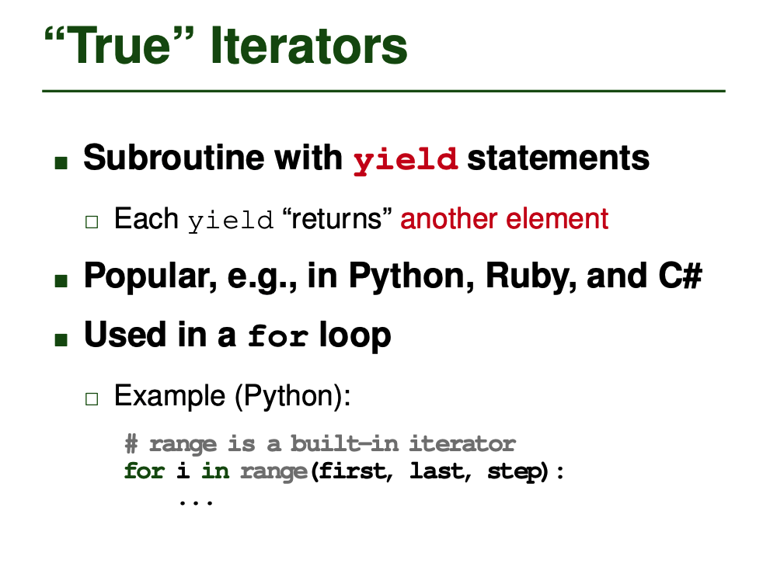
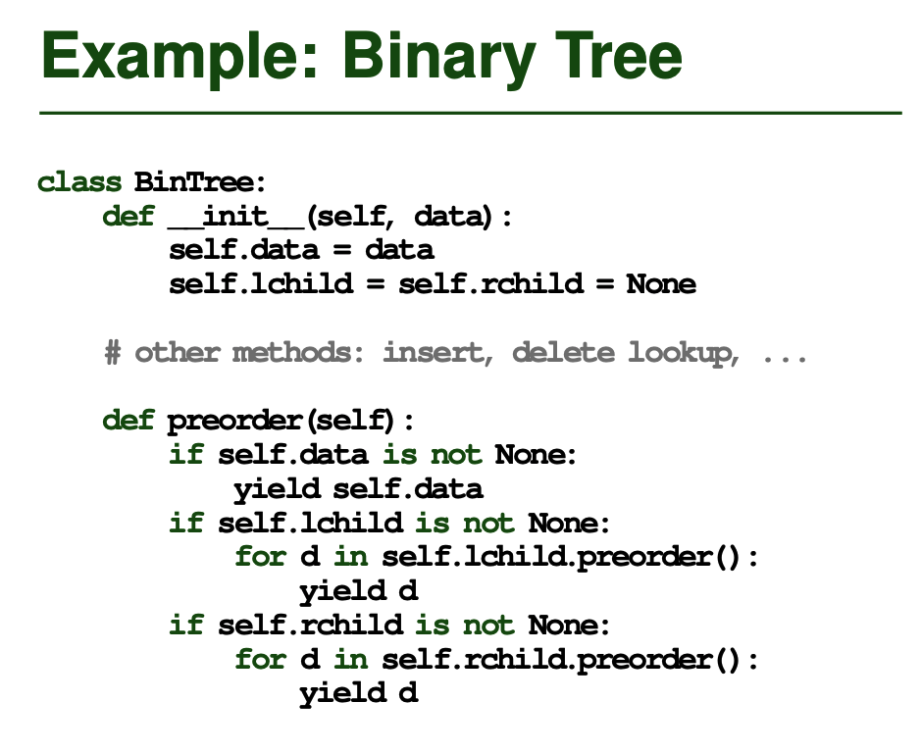
Iteration
q’s type is unknown until the actual code runs! It’s type can only be determined ("bound") once a variable is passed in!

Slide 124
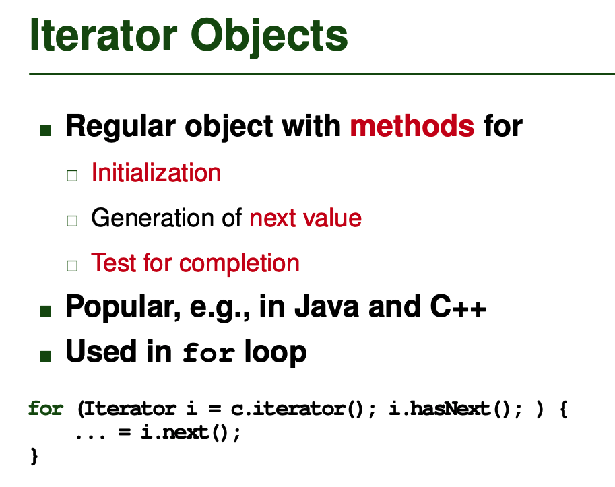
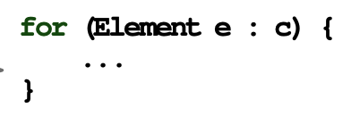
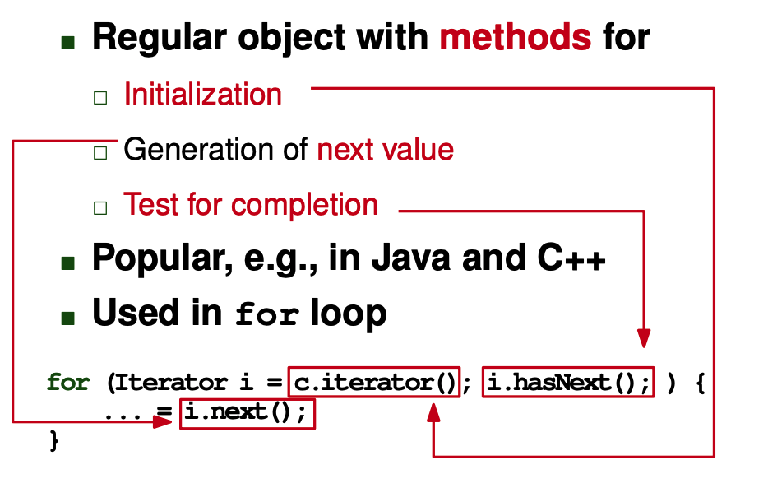
Iteration
q’s type is unknown until the actual code runs! It’s type can only be determined ("bound") once a variable is passed in!

Slide 125
Abstract methods are defined by specifying a prototype with no method implementation.
Classify That Language: Iteration
Consider the following program...
TODO
Thinking time!
This is ???!

Slide 126
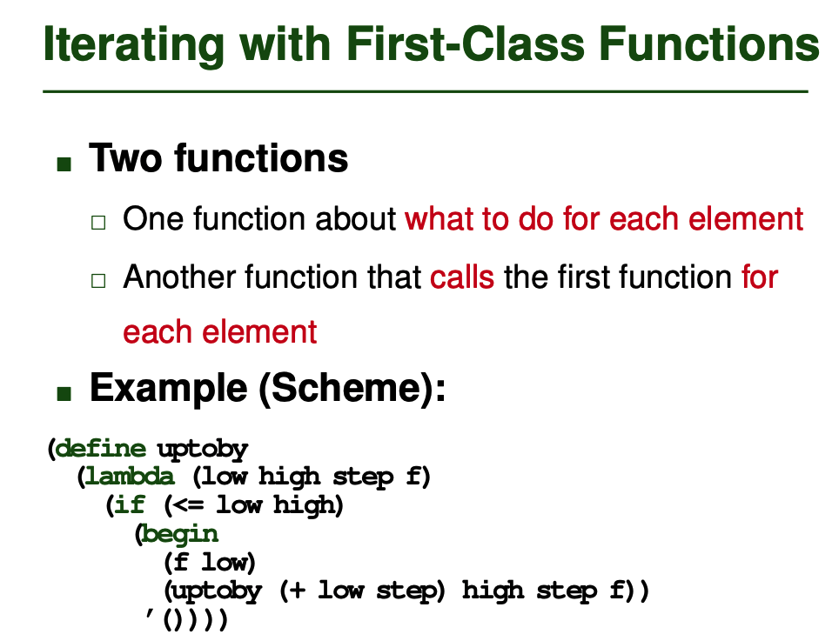
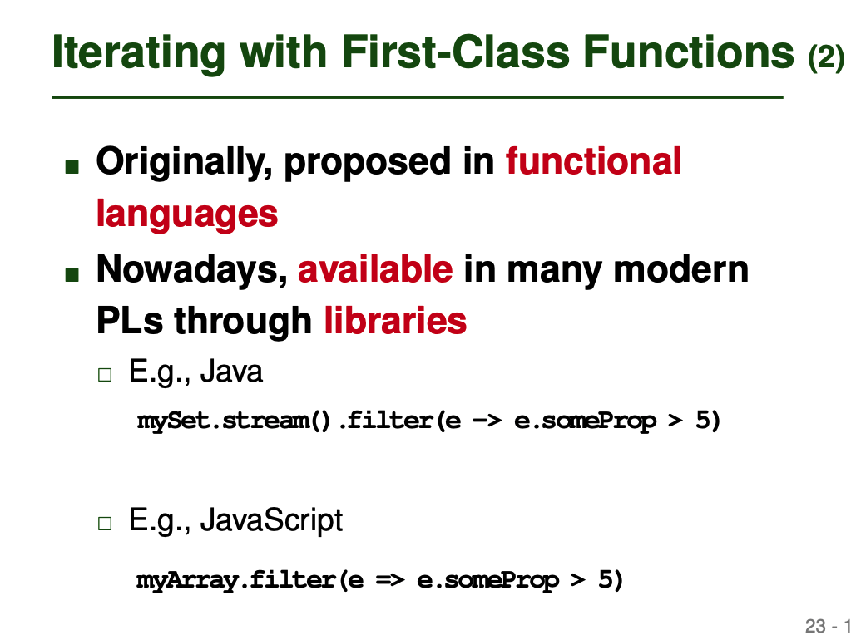
Iteration
q’s type is unknown until the actual code runs! It’s type can only be determined ("bound") once a variable is passed in!

Slide 127
Continuations
q’s type is unknown until the actual code runs! It’s type can only be determined ("bound") once a variable is passed in!
In low-level terms, a continuation consists of a code address and a referencing environment to be restored when jumping to that address. In higher-level terms, a continuation is an abstraction that captures a context in which execution might continue. Continuations are fundamental to denotational semantics. They also appear as first-class values in certain languages (notably Scheme and Ruby), allowing the programmer to define new control- flow constructs.
The implementation of continuations in Scheme and Ruby is surprisingly straightforward. Because local variables have unlimited extent in both lan- guages, activation records must in general be allocated on the heap. As a re- sult, explicit deallocation is neither required nor appropriate when jumping through a continuation; frames that are no longer accessible will eventually be reclaimed by a general purpose garbage collector (to be discussed in Sec- tion 7.7.3). Restoration of state (e.g., saved registers) from escaped routines is not required either: the continuation closure holds everything required to resume the captured context.

Slide 128
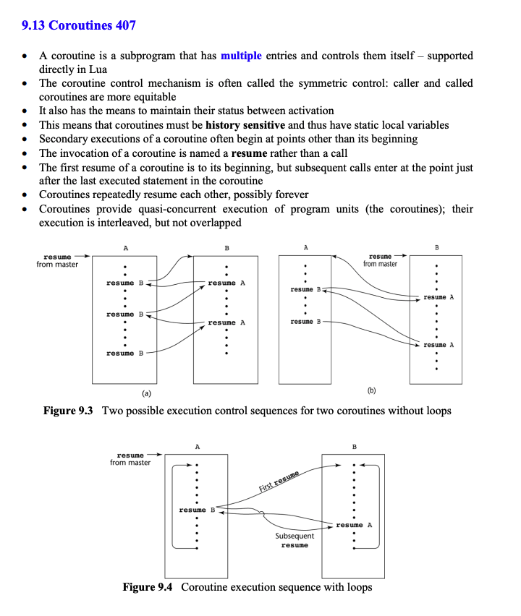
Multiprocessing
q’s type is unknown until the actual code runs! It’s type can only be determined ("bound") once a variable is passed in!
Cooperative multitasking, co-routines

Slide 129
Lazy Evaluation/Short Circuiting
q’s type is unknown until the actual code runs! It’s type can only be determined ("bound") once a variable is passed in!
5.1.1 Lazy evaluation
Evaluating expressions with boolean operators (and, or, not) is another area where the value of an expression
is not well-defined without a semantic definition. Consider the expression below.
if( a || (b && c && d) )
/* do something */;
The values a, b, c, and d may all be functions, possibly even functions that require lots of resources to
compute. Note that, if a is true, then the rest of the expression is irrelevant to the truth of the entire state-
ment. Only if a is false, does the rest of the statement require evaluation. The expression (b && c &&
d) also permits lazy evaluation, because if any of the individual items are false, the entire statement is
false. Therefore, the most efficient method of evaluating the expression is to treat it as a set of nested
if-statements.
if(b) {
if(c) {
if(d) {
/* do something */
}
}
}

Slide 130
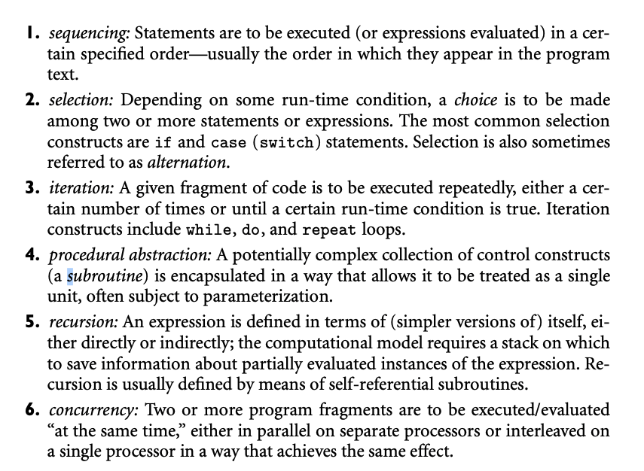
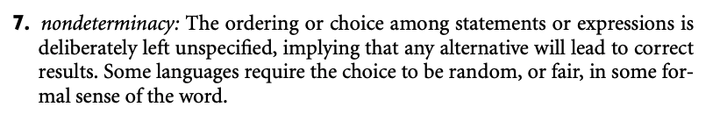
First Lecture
Short circuiting (sidefx)
Looping mechanisms, break, continue?
Second lecture
generators in python/yield
Concurrency
Ownership (rust)
Fork/join
Global Interpreter Lock
Parking lot
"definite assignment" compiler checking that a variable is assigned across all control paths. Can happen at compile time or dynamically at runtime

Slide 131
Iteration: Looping With a Counter
def foo(n):
while n != 1:
print(n)
if n % 2 == 0:
n //= 2
else:
n = 3*n + 1
// Perl
for(my $x = 1; $x <= 5; $x++) {
for(my $y = 1; $y <= $x; $y++) {
print "*";
}
print "\n";
}
for i in range(1,10):
print(i)
Are the values iterators
for (int i=0;i<10;++i)
cout << i << endl;
for (r=1; r != 0; r = rand())
cout << r << endl;
list<int> items;
list<int>::iterator it;
...
for (it = items.begin();
it != items.end();
++it)
cout << *it << endl;
cin >> n;
while (n != 1) {
if (n % 2 == 0) n = n / 2;
else n = 3*n + 1;
}
list<int> items;
...
for (int item: items)
cout << items << endl;
int secret_num = rand();
do {
cin >> guess;
} while (guess != secret_num);
i = 0;
while (i < 10) {
// code that impacts condition
}

Slide 132
Conditionals: Beyond If Statements
First let's discuss the conditional ternary operator – it's an operator with 3 operands!
This is called the elvis operator because if you turn it on its side, it looks like Elvis!
Here are its semantics: If boolean_condition is True return A else return B
// C++, C#, Java, JavaScript, Swift, etc. beverage = age < 21 ? "Coke" : "Beer";
?:
# Python conditional operator beverage = "Coke" if age < 21 else "Beer"
// Kotlin conditional operator beverage = if age < 21 "Coke" else "Beer"
if (drink != null) my_bev = drink;
else my_bev = "water";
if (article == null)
name = null
else if (article.co_author == null)
name = null
else
name = article.co_author.name
There are also shortened versions that check for NULL, in some languages:
Here are their semantics: If A is not NULL return A else return B
// C#, JavaScript, Swift
my_bev = drink ?? "water";
// Kotlin Elvis operator
my_bev = drink ?: "water"
Finally, some languages support an inline version of this operator!
// C#, Kotlin, JavaScript, Swift, ...
name = article?.co_author?.name
# Ruby's slightly different syntax
name = article&.co_author&.name
Notes:
-- OCaml guards let select_beverage a =
match a with
| a when a < 21 -> "Coke"
| a when a >= 21 -> "Beer"
;;
-- Haskell guards select_beverage age
| age < 21 = "Coke"
| otherwise = "Beer"

Slide 133
Abstract methods are defined by specifying a prototype with no method implementation.
Classify That Language: Multi-way Selection
let fraction = (5, 6)
...
switch fraction {
case let (num, denom) where denom == 0:
print("The value is infinity")
case let (num, denom) where num >= denom:
print("\(num/denom) is greater than 1")
case let (num, denom):
print("\(num/denom) is a fraction")
}
Consider the following program...
TODO
Thinking time!
This is Swift!

Slide 134
Looping and Iterators
Next let's learn how iteration actually is implemented under the hood:
vector<string> fruits = {"plum","pear",...};
for (auto f: fruits)
cout << f << endl;
for i in range(1,10):
print(i)
There are two high-level approaches:
Iterator Objects
Internal Iteration
iterable object
get_val()
at_end()
advance()
ptr
iterable object
get_iterator() { ... }
for_each(f) {
for i=0 to num(items):
f(item[i])
}
iterator
object
We can pass a lambda that accepts one argument – it'll call it on each element.
List<String> fruits = new ArrayList<>();
// ... Add a bunch of fruits
while (fruits.hasNext())
System.out.println(fruits.next())
List<String> fruits = new ArrayList<>();
// ... Add a bunch of fruits
fruits.forEach(ft -> System.out.println(ft));
Java's hasNext() sees if there are any items left.
Java's next() returns the current item and advances one item forward.

Slide 135
Iterators
What’s the big picture?
An iterable class is one which contains a collection of values that can be processed sequentially.
Examples: arrays, lists, sets, maps, ranges
In OOP languages, we use an abstraction called an "iterator" to point at, retrieve, and advance through the values in an iterable object.
set<string> nerds;
... // add items to nerds set
set<string>::iterator it;
it = nerds.begin();
while (it != nerds.end()) {
cout << *it << endl;
++it;
}

Slide 136
Concurrency Approaches
Let's break down the high-level approaches to concurrency in modern languages.
Full Multithreading
A program may launch any number of threads, and their execution is interleaved across available cores
C++, Java, C#, Kotlin, Rust, etc.
Limited Multithreading
The language supports concurrent execution, but there are constraints preventing some kinds of parallelism
Python
Simulated Multithreading
The language supports concurrent execution, but all execution is actually limited to a single thread
JavaScript, TypeScript, etc.

Slide 137

Callbacks
<html><body>
<div>The current weather is:</div>
<div id="weather">No weather data</div>
<script>
function update_weather_text(txt)
{ document.getElementById("weather").innerHTML = txt; }
function update_ui_when_data_arrives()
{ update_weather_text(this.responseText); }
function download_weather() {
var req = new XMLHttpRequest();
req.onreadystatechange = update_ui_when_data_arrives;
req.open("GET", "https://www.weather.com/...", true);
req.send();
}
download_weather()
update_weather_text("Retrieving weather...")
</script>
</body></html>
www.weather.com
req
onreadystatechange
responseText
// starts execution in background
"77 degrees and cloudy"
Notes:
Actual Javascript code:
<html><body>
<div>The current weather is:</div>
<div id="weather">No weather data</div>
<script>
function update_weather_text(txt)
{ document.getElementById("weather").innerHTML = txt; }
function update_ui_when_data_arrives()
{ update_weather_text(this.responseText); }
function download_weather() {
var req = new XMLHttpRequest();
req.onreadystatechange = update_ui_when_data_arrives;
req.open("GET", "https://www.weather.com/...", true);
req.send();
}
download_weather()
update_weather_text("Retrieving weather...")
</script>
</body></html>

Slide 138
UI Programming Without Concurrency
Updating the display doesn't happen until the next iteration.
Here's an example of how a browser without concurrency would run:
The browser hangs until the operation finishes!
www.weather.com
# Browser pseudocode
def render_browser_UI():
while True:
display_UI_in_browser()
check_for_mouse_and_keyboard_events() run_next_js_statement_to_completion()
This changes the contents of the page, but doesn't update the screen just yet!
<html><body>
<div>The current weather is:</div>
<div id="weather">No weather data</div>
<script>
function update_weather(data) { ... }
data = download("www.weather.com/...");
update_weather(data);
</script>
</body></html>
This is called a "blocking" operation.
Notes:
def compute(data, callback_fn): result = some_long_running_op(data)
callback_fn(result)
def use_results(results):
# does something with results
data = <some object we want to operate on>
print("Starting!")
run_asynch(lambda: compute(data, use_results))
print("compute() is running in the background!")

Slide 139
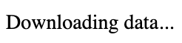
UI Programming With Concurrency and Callbacks
Execution continues immediately in our browser main loop!
www.weather.com
# Browser pseudocode
def render_browser_UI():
while True:
display_UI_in_browser()
check_for_mouse_and_keyboard_events() run_next_js_statement_to_completion()
Here's our updated code to download the file...
Let's use a version that can run in the background...
This changes the contents of the page, but doesn't update the screen just yet!
Notice that we passed our update_weather() function as a parameter.
Our downloader will call the callback to updates the page contents with the temperature, etc.
This launches a downloader in the background.
<html><body>
<div>The current weather is:</div>
<div id="weather">No weather data</div>
<script>
function update_weather(data) { ... }
data = download_concur("www.weather.com/...",
update_weather);
update_weather("Downloading data...");
</script>
</body></html>
When the file finishes downloading...
And we'll add a status update to our page so the user knows what's happening.
Downloader Object
Progress...
callback
Notes:
def compute(data, callback_fn): result = some_long_running_op(data)
callback_fn(result)
def use_results(results):
# does something with results
data = <some object we want to operate on>
print("Starting!")
run_asynch(lambda: compute(data, use_results))
print("compute() is running in the background!")

Slide 140
UI Programming With Concurrency and Callbacks
www.weather.com
Let's define a callback function that will update the web page once we download our weather data.
<html><body>
<div>The current weather is:</div>
<div id="wthr_txt">No weather data</div>
<script>
function show_weather(data) {
update_html("wthr_txt", data);
}
download_concur("www.weather.com/...",
show_weather);
update_html("wthr_txt", "Downloading data...");
// other javascript code
// ...
// ...
</script>
</body></html>
Let's use a version of the downloader that can run concurrently (in the background).
This launches a downloader in the background.
When the file finishes downloading...
And we'll add a status update to our page so the user knows what's happening.
Notice that we pass our show_weather() callback as a parameter.
Downloader Object
Progress...
Our downloader will call the callback to update the page contents with the temperature, etc.
callback
Notes:
def compute(data, callback_fn): result = some_long_running_op(data)
callback_fn(result)
def use_results(results):
# does something with results
data = <some object we want to operate on>
print("Starting!")
run_asynch(lambda: compute(data, use_results))
print("compute() is running in the background!")

Slide 141
Solution #2: Promises
The worker calls this function if it has a successful result.
The worker calls this function if it has an error.
So how do you create a stage in the pipeline? Each stage has two parts:
function worker_for_stage_x(resolve_fn, reject_fn) {
output = do_the_actual_work_for_stage_x();
if (was_successful(output))
resolve_fn(output);
else
reject_fn("Error doing stage x!");
}
function stage_x() {
p = Promise(
lambda (resolve_fn, reject_fn) {
run_in_background worker_for_stage_x(resolve_fn, reject_fn)
}
);
return p;
}
First, we define a worker function that does the actual work.
This function creates a new Promise object.
The worker takes two functions as its arguments.
The worker does it's work.
If the worker succeeds, it calls the resolve_fn() function and passes its output.
Next, we create a separate function that creates a promise for this stage of the pipeline.
Otherwise, the worker calls the reject_fn() function.
And passes in a lambda function that calls the worker.
function run_async_pipeline() {
stage_1()
.then(lambda (stage1_result)
{
return stage_2(initial_stage_result);
}
)
.then(lambda (stage2_result)
{
return stage_3(second_stage_result);
}
)...
}
}

Slide 142
What's a Promise?
A promise is an object that launches an asynchronous task and tracks its status.
When you create a Promise object, you give it a lambda function to run.
The Promise object c'tor runs the lambda function, which is responsible for kicking off a background task.
Then the promise constructor then immediately returns, and execution resumes with the next statement.
At some later point, the task finishes (in the background) and sends its output/status back to the promise object.
At this point, the promise is fulfilled.
A promise object may have subscribers.
You may register a lambda function that runs once a lambda completes
For the gory details, see a great explanation from Timothy Gu in the slide notes!
Notes:
https://github.com/TimothyGu/learning-promises/blob/main/by-building/README.md
The Promise object starts by launching the lambda function asynchronously, then immediately returns.

Slide 143
UI Programming Without Concurrency 2
Here's an example of how javascript that doesn't use concurrency would run:
The browser hangs until the operation finishes!
www.weather.com
Clearly, if we have to run a function that takes a while to run, it'll freeze our UI.
So we have to figure out a way to run such a function in the background.
This is called a "blocking" operation.
<html><body>
<div>The current weather is:</div>
<div id="weather">No weather data</div>
<script>
function update_html(tag,value) { ... }
download("www.weather.com/...",
lambda (data) {
update_html("weather", data); });
// other javascript code...
// ...
</script>
</body></html>
And then get the result once it's done.
This way, the rest of the page can continue handling user interaction without stalling.
Notes:
def compute(data, callback_fn): result = some_long_running_op(data)
callback_fn(result)
def use_results(results):
# does something with results
data = <some object we want to operate on>
print("Starting!")
run_asynch(lambda: compute(data, use_results))
print("compute() is running in the background!")

Slide 144
What's a Promise?
Promise object
PENDING
A Promise is an object that launches a task, tracks its execution, and receives its result once the task completes.
status
SUCCESS
The promise object updates its status and keeps a copy of the output.
output
nil
"<HTML>..."
When you create a Promise object, you give it a lambda function to run – the lambda is used to launch its task.
p = Promise(lambda (data) { run_in_background task(data, ...); }
);
...
Think of a Promise like a promise you make to someone that you'll get something done, e.g.:
"I promise to deliver you a taco at some point in the future."
The Promise object's constructor runs the lambda function, which launches the task in the background.
task()
While it's not shown here, the task is also passed information on its Promise, so it can report status.
The lambda function is responsible for launching a background task associated with the Promise.
c'tor
Then the Promise's constructor immediately returns, and the main program resumes normally.
task()
c'tor
program resumes...
At some later point, the background task finishes and sends its output/status back to its Promise object.
function task(data, my_promise) {
...
my_promise.i_succeeded(output);
}
At this point, the Promise is "fulfilled," meaning the background task has delivered its result to the Promise.
Notes:
Alternative Definition: A Promise is an object that acts as a proxy for a result that is initially unknown because the computation of its value is not yet complete.
A promise is an object that promises to deliver the result of a background task in the future once the task finishes running, and optionally launch a followup background task and pass the first task's result to it once the first promise is fulfilled.
A Promise is an object that tracks a first task's execution (and can launch a second task when the first is done).

Slide 145

What's a Promise?
Sarcastic Robot Says:
"Many built-in language libraries auto-
matically support promises, making them easy to use with simple syntax.
But wait 'til you have to write your own! :/"
Promise object
lambda (x)
{ return task2(x); }
status
PENDING
SUCCESS
You typically provide a Promise object with a subscriber function that is called if/when the promise is fulfilled.
output
nil
"<HTML>..."
subscriber
To add a subscriber, you register a lambda function with the Promise object, e.g., p.then(...).
p = Promise(...);
p.then(lambda (x) { task2(x); } );
When a Promise is fulfilled, it passes the output/status of the task it was tracking to its subscriber function.
task()
task()
task()
"<HTML>..."
task2()
"<HTML>..."
"<HTML>..."
"<HTML>..."
subscriber
subscriber
This means: "Once the Promise is fulfilled, please call this lambda function with its output."
Once you've constructed your pipeline, it executes entirely in the background!
p.i_succeeded()
p.i_succeeded()
p.i_succeeded()
c'tor
Promise object
The subscriber creates a new Promise which launches a new task to process the previous stage's output.
status
PENDING
output
nil
subscriber
p = Promise(...);
p.then(lambda (x) { task2(x); } )
.then(lambda (y) { task3(y); } )
.then(...)
You can chain together many subscribers, creating a pipeline of asynchronous routines to process data.
Notes:
* Technically, every then() call that's chained creates a new promise, but let's skip over the details.

Slide 146
Callbacks Can Get Ugly (exp)
function download_in_background_then_run_cb(url, callback1) {
run_in_background {
data = connect_and_download_data(url)
callback1(data)
}
}
function filter_in_background_then_run_cb(data, callback2) {
run_in_background {
fdata = filter_data(data)
callback2(fdata);
}
}
function reorder_in_background_then_run_cb(fdata, callback3) {
run_in_background {
sdata = sort(fdata)
callback3(sdata);
}
}
function display_in_ui(sdata) { ... }
Often, we need to chain a bunch of slow background operations together with multiple callbacks, e.g.:
Our first function downloads a file.
download a file, then filter the data,
then sort the remaining data,
then update the UI.
Once it's done we ask it to run a callback to initiate the next stage of processing.
For example, consider the following functions...
That next stage might filter the DLed data.
Once it's done we ask it to launch a callback to do the next stage of processing.
To do chain functions like this, people use lambdas.
That final stage might display the data in the UI.
That next stage might sort the filtered data.
Once it's done we ask it to launch a callback to do the last stage of processing.
Let's see!
Notes:
function download_data(url) {
run_in_background((url) => {
// code to connect and download data from URL
run_in_background((data) => {
// code to filter data
run_in_background((filtered_data) => {
// code to update the UI
})
})
})
}

Slide 147
Callbacks Can Get Ugly (exp)
Let's see how we do end-to-end processing and display our data.
Let's see the details of this lambda function.
function display_sorted_filtered_data(url) {
download_in_background_then_run_cb(
url,
lambda (data) {
filter_data_in_background_then_run_cb(
data,
lambda (fdata) {
reorder_data_in_background_then_run_cb(
fdata,
lambda (sdata) {
display_in_ui(sdata);
}
);
}
);
}
);
}
Let's see the details of this lambda function.
lambda (data) { /* runs filter step in background */ }
The first thing we do is call our download function.
For our callback, we want to pass a lambda that launches the filtering step in the background.
lambda (fdata) { /* runs sorting in BG */ }
The lambda will be called with the downloaded data once we finish downloading the file.
Let's see the details of this lambda function.
The lambda calls the function to filter the downloaded data.
lambda (sdata) { /* displays in UI */ }
It sorts the filtered data.
For our callback, we want to pass a lambda that launches the sorting step in the background.
For our callback, we pass in a lambda that performs the final plotting step.
Notes:
function download_data(url) {
run_in_background((url) => {
// code to connect and download data from URL
run_in_background((data) => {
// code to filter data
run_in_background((filtered_data) => {
// code to update the UI
})
})
})
}

Slide 148
Callbacks Can Get Ugly (exp) - TODO
Once we finish downloading the data...
In this way, we break what would be one long task into a series of shorter background tasks.
When a task finishes, it runs its callback to launch the next background task.
function display_sorted_filtered_data(url) {
download_in_background_then_run_cb(
url,
lambda (data) {
filter_data_in_background_then_run_cb(
data,
lambda (fdata) {
reorder_data_in_background_then_run_cb(
fdata,
lambda (sdata) {
display_in_ui(sdata);
}
);
}
);
}
);
}
DOWNLOAD
FILTER
SORT
Once we finish filtering the data...
UI
PLOT
We run a callback that sorts the data...
Once we finish sorting the data...
We run a callback that displays the data...
This enables the UI to keep running while we're doing processing.
We run a callback that filters the data...
Notes:
function download_data(url) {
run_in_background((url) => {
// code to connect and download data from URL
run_in_background((data) => {
// code to filter data
run_in_background((filtered_data) => {
// code to update the UI
})
})
})
}

Slide 149
Solution #3:Async/Await
function download_data(url){
while (!done) {
get_data()
save_data()
}
return result;
}
Of course, there's no reason you have to launch tasks serially like our previous example.
function filter_data(data) {
while (!done) {
foo();
bar();
}
return result;
}
Let's see.
function sort_data(data) {
while (!done) {
divide();
conquer();
}
return result;
}
Launch the Async Function
You request execution of one or more functions in the background and obtain handle(s) to the pending task(s).
async function run(data1, data2, data3) {
h1 = run_async task1(data1);
h2 = run_async task2(data2); h3 = run_async task3(data3);
... // Do other stuff in the meanwhile...
result1 = await h1 # block until task1 is done
result2 = await h2 # block until task2 is done
result3 = await h3 # block until task3 is done
use_results(result1, result2, result3)
}
Wait for Completion
You may optionally wait for your task(s) to complete their execution, and then obtain their result.

Slide 150
Callbacks Can Get Ugly
function download_data(url, callback1) {
run_in_background {
data = connect_and_download_data(url)
callback1(data)
}
}
function filter_data(data, callback2) {
run_in_background {
fdata = filter_data(data)
callback2(fdata);
}
}
function reorder_data(fdata, callback3) {
run_in_background {
sdata = sort(fdata)
callback3(sdata);
}
}
function display_in_ui(sdata) { ... }
Often we need to chain a bunch of slow background operations together with multiple callbacks, e.g.:
download a file, then filter the data,
then sort the remaining data,
then update the UI.
Our first function downloads a file.
Once it's done we ask it to run a callback to initiate the next stage of processing.
For example, consider the following functions...
That next stage might filter the DLed data.
Once it's done we ask it to launch a callback to do the next stage of processing.
To do chain functions like this, people use lambdas.
That final stage might display the data in the UI.
That next stage might sort the filtered data.
Once it's done we ask it to launch a callback to do the last stage of processing.
Let's see!
Notes:
function download_data(url) {
run_in_background((url) => {
// code to connect and download data from URL
run_in_background((data) => {
// code to filter data
run_in_background((filtered_data) => {
// code to update the UI
})
})
})
}

Slide 151
Callbacks Can Get Ugly
Let's see how we do end-to-end processing and display of our data.
function reorder_data(fdata, callback3) {
run_in_background {
sdata = sort(fdata)
callback3(sdata);
}
}
function filter_data(data, callback2) {
run_in_background {
fdata = filter_data(data)
callback2(fdata);
}
}
function download_data(url, callback1) {
run_in_background {
data = connect_and_download_data(url)
callback1(data)
}
}
The first thing we do is call the download_data() function.
The lambda will be called with the filtered data when it's ready.
The lambda will be called with the downloaded data once we finish downloading the file.
Let's see the details of this lambda function.
function display_sorted_filtered_data() {
url = ...
download_data(url,
lambda (data) {
filter_data(data,
lambda (fdata) {
reorder_data(fdata,
lambda (sdata) {
display_in_ui(sdata);
}
);
}
);
}
);
}1
Let's see the details of this lambda function.
Let's see the details of this lambda function.
lambda (data) { /* runs filter step in background */ }
lambda (fdata) { /* runs sorting in BG */ }
For our callback, we want to pass a lambda that launches the filtering step in the background.
The lambda calls the filter_data() function.
lambda (sdata) { /* displays in UI */ }
It calls the reorder_data() function to sort the filtered data.
For our callback, we want to pass a lambda that launches the sorting step in the background.
For our callback, we pass in a lambda that performs the final plotting step.
Notes:
function download_data(url) {
run_in_background((url) => {
// code to connect and download data from URL
run_in_background((data) => {
// code to filter data
run_in_background((filtered_data) => {
// code to update the UI
})
})
})
}

Slide 152
Callbacks Can Get Ugly
In this way, we break what would be one long task into a series of shorter background tasks.
Once we finish downloading the data...
We run a callback that filters the data...
When a task finishes, it runs its callback to launch the next background task.
DOWNLOAD
FILTER
SORT
We run a callback that sorts the data...
function display_sorted_filtered_data() {
url = ...
download_data(url,
lambda (data) {
filter_data(data,
lambda (fdata) {
reorder_data(fdata,
lambda (sdata) {
display_in_ui(sdata);
}
);
}
);
}
);
}
UI
PLOT
We run a callback that displays the data...
Once we finish filtering the data...
This enables the UI to keep running while we're doing processing.
Once we finish sorting the data...
Notes:
function download_data(url) {
run_in_background((url) => {
// code to connect and download data from URL
run_in_background((data) => {
// code to filter data
run_in_background((filtered_data) => {
// code to update the UI
})
})
})
}

Slide 153
Callbacks Can Get Ugly
Unfortunately, this nesting can get ugly!
In fact, it's so nasty, it has a name: "callback hell" or "pyramid of doom."
So of course, programming language designers came up with a better alternative.
function display_sorted_filtered_data() {
url = ...
download_data(url,
lambda (data) {
filter_data(data,
lambda (fdata) {
reorder_data(fdata,
lambda (sdata) {
display_in_ui(sdata);
}
);
}
);
}
);
}
Notes:
filter_data() { did some background thread/processing, then calls the callback to reorder }

Slide 154
Solution #2: Promises
Note: You can only use this syntax if you modify these functions to use "Promise objects"!
In our previous example, we first download a file, and then filter the data, and then sort the remaining data, and then plot the data in the UI.
Wouldn't it be nice if we could use a simpler syntax than callbacks? How about this?
function display_sorted_filtered_data(url) {
download_data(url)
.then(lambda (downloaded_data) { filter_data(downloaded_data); } )
.then(lambda (filtered_data) { sort_data(filtered_data); } )
.then(lambda (sorted_data) { update_ui(sorted_data); } )
}
function display_sorted_filtered_data(url) {
download_data(url)
.then(lambda (downloaded_data) { filter_data(downloaded_data); } )
.then(lambda (filtered_data) { sort_data(filtered_data); } )
.then(lambda (sorted_data) { update_ui(sorted_data); } )
}
This chunk of code defines a pipeline of operations.
Each phase of the "pipeline" does its work (in the background), produces a result, and the framework passes that result to the next lambda in the pipeline.
This uses an approach called "Promises."

Slide 155
Solution #2: Promises
This chunk of code defines a pipeline of operations.
Execution of the pipeline happens concurrently!
When you create a pipeline like this, it doesn't run synchronously... it runs concurrently!
function display_sorted_filtered_data(url) {
download_data(url)
.then(lambda (downloaded_data) { filter_data(downloaded_data); } )
.then(lambda (filtered_data) { sort_data(filtered_data); } )
.then(lambda (sorted_data) { update_ui(sorted_data); } )
}
do_first_thing();
display_sorted_filtered_data("www.weather.com/...);
while (!done) {
do_other_stuff();
do_even_more_stuff();
}
function download_data(url){
while (!done) {
get_data()
save_data()
}
return result;
}
function filter_data(data) {
while (!done) {
foo();
bar();
}
return result;
}
Execution continues instantly on the next line.
This pipeline won't run to completion here! It's just started here, and runs in the background.
function sort_data(data) {
while (!done) {
divide();
conquer();
}
return result;
}
function update_ui(data) {
...
}
The Promise approach is syntactic sugar for callbacks!

Slide 156
Solution #2: Promises
If this step of the pipeline generates an error.
If this step of the pipeline generates an error.
OK, what about dealing with errors?
To do so, we use an "exception-like" syntax – but it's not exceptions!
function display_sorted_filtered_data(url) {
download_data(url)
.then(lambda (downloaded_data) { filter_data(downloaded_data); } )
.then(lambda (filtered_data) { sort_data(filtered_data); } )
.then(lambda (sorted_data) { update_ui(sorted_data); } )
.catch(lambda (error) => { address_all_errors(error); } )
}
function display_sorted_filtered_data(url) {
download_data(url)
.then(lambda (downloaded_data) { filter_data(downloaded_data); } )
.then(lambda (filtered_data) { sort_data(filtered_data); } )
.then(lambda (sorted_data) { update_ui(sorted_data); } )
}
function display_sorted_filtered_data(url) {
download_data(url)
.then(lambda (downloaded_data) { filter_data(downloaded_data); } )
.then(lambda (filtered_data) { sort_data(filtered_data); } )
.then(lambda (sorted_data) { update_ui(sorted_data); } )
}
.catch(lambda (error) => { deal_with_dl_error(error); } )
.catch(lambda (error) => { deal_with_filter_error(error); } )
This catch error handler runs...
And if you don't catch something in-line, you can also catch errors from any phase of the pipeline at the end.
This catch error handler runs...
Although this provides less error-handling granularity, and thus should be avoided.

Slide 157
Promises – Easy to Consume, Hard to Build From Scratch
Many languages have libraries that are built on-top of promises.
For example, if you use JavaScript's fetch() function, it supports the .then() and .catch() syntax automatically!
function loadContent () {
fetch("https://www.foo.com/...")
.then((result) => {
if (result.status != 200) {
throw new Error("Bad Server Response");
}
return result.text();
})
.then((content) => {
set_text("field", content);
})
}
If you'd like to learn more about Promises, see Timothy Gu's awesome writeup in the slide notes below.
But if you have to build functions from scratch to support Promises, things get much more confusing.
Notes:
https://github.com/TimothyGu/learning-promises/blob/main/by-building/README.md

Slide 158
Promises In Different Languages
function loadContent () {
fetch("https://www.foo.com/...")
.then((result) => {
if (result.status != 200) {
throw new Error("Bad Server Response");
}
return result.text();
})
.then((content) => {
set_text("field", content);
})
}
TODO Another language
If you'd like a really great writeup about how JavaScript Promises work, see the slide notes for a writeup by Timothy Gu!
Notes:
https://github.com/TimothyGu/learning-promises/blob/main/by-building/README.md

Slide 159
UI Programming Without Concurrency
Here's an example of how javascript that doesn't use concurrency would run:
The browser hangs until the operation finishes!
www.weather.com
Clearly, if we have to run a function that takes a while to run, it'll freeze our UI.
So we have to figure out a way to run such a function in the background.
This is called a "blocking" operation.
<html><body>
<div>The current weather is:</div>
<div id="weather">No weather data</div>
<script>
data = download("www.weather.com/...");
update_html("weather", data);
// other javascript code...
// ...
</script>
</body></html>
And then get the result once it's done.
This way, the rest of the page can continue handling user interaction without stalling.
Notes:
def compute(data, callback_fn): result = some_long_running_op(data)
callback_fn(result)
def use_results(results):
# does something with results
data = <some object we want to operate on>
print("Starting!")
run_asynch(lambda: compute(data, use_results))
print("compute() is running in the background!")

Slide 160
Callbacks
Idea: You run a long-running task in the background, and give it call a "callback" function to call when it finishes; the callback updates the UI with the task's results.
# pseudocode showing use of callbacks
def call_when_done(result):
# does something with the result, e.g.,
update_webpage_with_results(result)
def task(callback_fn):
result = some_long_running_op()
callback_fn(result)
run_in_background task(call_when_done)
while page_is_not_closed():
handle_user_interactions_with_page()
The callback function accepts a parameter which is the result of a task – it uses the result to update the UI.
This would correspond to downloading the file in the previous slide.
The task function performs an operation, gets a result, and then calls the callback function with the result.
This launches our task in the background.
(this is pseudo-syntax)
def some_long_running_op():
while (!done):
blah()
bletch()
blurb()
return result
You launch your task so it runs concurrently with the main thread.
Our task is done, so it runs the callback, then terminates.
Now your main program can continue running and get notified when the task is complete via the callback.
Our main UI code continues normally.
Notes:
A callback function is a function that is called upon completion of a (concurrent) task.

Slide 161
Callback Example: Handling Button Clicks
The programmer defines a UI element like a button...
And tells the button what callback function to call...
<html>
<body>
<h1>Button-click Callback Example</h1>
<p>This is what I think:</p>
<p id="truth">USC is great</p>
<button onclick="callbk();">Click Me</button>
<script>
function callbk() {
document.getElementById("truth").innerHTML +=
"ly overrated";
}
</script>
</body>
</html>
Callback functions are also used to handle user-driven events in the browser.
This includes the user clicking buttons, dragging items, etc.
When an action occurs, like the button is clicked.
www.truth.com

Slide 162
Stringing Background Ops Together (hide?)
function download_data(url, callback1) {
run_in_background {
data = connect_and_download_data(url)
add_to_run_queue callback1(data)
}
}
function filter_data(data, callback2) {
run_in_background {
fdata = filter_data(data)
add_to_run_queue callback2(fdata);
}
}
function sort_data(fdata, callback3) {
run_in_background {
sdata = sort(fdata)
add_to_run_queue callback3(sdata);
}
}
function display_in_ui(sdata) { ... }
Here's pseudocode for what's happening.
To accomplish this with "real" code, the syntax is actually much uglier.
Let's see!
Notes:
function download_data(url) {
run_in_background((url) => {
// code to connect and download data from URL
run_in_background((data) => {
// code to filter data
run_in_background((filtered_data) => {
// code to update the UI
})
})
})
}

Slide 163
Async/Await Syntax for Chaining Operations
DOWNLOAD
FILTER
SORT
The Async/Await model is yet another approach for concurrent programming with easier syntax.
<function paused>
When you use this paradigm, there are two phases for executing tasks.
We can also leave out the handles, for even simpler syntax.
This launches the task(s) in the background.
L
A
L
A
L
A
PLOT
Launch the Async Function
You request execution of one or more functions in the background and obtain handle(s) to the pending task(s).
function display_sorted_filtered_data(url) {
data = await launch_async download_data(url);
fdata = await launch_async filter_data(data);
sdata = await launch_async sort_data(fdata);
update_ui(sdata);
}
function display_sorted_filtered_data(url) {
h1 = launch_async download_data(url);
downloaded_data = await h1;
h2 = launch_async filter_data(downloaded_data);
filtered_data = await h2;
h3 = launch_async sort_data(filtered_data);
sorted_data = await h3;
update_ui(sorted_data);
}
After launch, the current function continues running immediately.
Wait for Completion
You may optionally wait for your task(s) to complete their execution, and then obtain their result.
This provides the same semantics as our promise-based code!
Await suspends execution of our current function until the async task finishes and returns a result.
This has the same semantics as Promises, but much more readable syntax.
Once we get a result, the thread continues executing.
The code looks synchronous, but in fact it's asynchronous!

Slide 164
Async/Await Syntax for Chaining Operations
Most languages also allow you to wait on multiple handles at the same time before proceeding, almost like a fork-join.
Launch the Async Function
You request execution of a function in the background and obtain a handle to the pending task.
async function run(data1, data2, data3) {
h1 = launch_async task1(data1);
h2 = launch_async task2(data2); h3 = launch_async task3(data3);
... // Do other stuff in the meanwhile...
await_all [h1, h2, h3];
... // Continue here once task1-task3 finish
}
Wait for Completion
You may optionally wait for your launched task to complete its execution, and then obtain its result.

Slide 165
Short Circuiting
Virtually all modern languages have some form of short-circuiting.
And some even provide syntax for both options so you can choose to use it or not.
// Kotlin
fun main() {
val cute = true; val smart = false; val rich = true;
if (cute == true || smart == true || rich == true)
print("Only evaluates the first term\n");
if (cute == true or smart == true or rich == true)
print("ALWAYS evaluates all three terms!\n");
}
Notes:
fun rich(salary: Int): Boolean {
if (salary > 200001) return true;
print("Not in silicon valley!\n")
return false
}
fun main() {
val cute = true; val smart = false;
val salary = 200000;
if (cute == true || smart == true || rich(salary) == true)
print("You're my type!\n")
if (cute == true or smart == true or rich(salary) == true)
print("I still want to date you!\n")
}

Slide 166
Models for Concurrency
There are two primary approaches for implementing concurrency:
Threading Model
Your program creates multiple "threads" of execution that run concurrently (potentially in parallel).
The programmer explicitly "launches" one or more functions in their own threads, and the OS schedules their execution across available CPU cores.
Event Driven Model
A program is a list of associations, each between an event (e.g., the user clicked a UI button) and a function f() that must be called when that event occurs.
After initial setup, functions are run if/when a related event occurs that triggers the function's execution.
// Multi-threaded program (pseudocode)
void handle_user_purchase(User u, Item i) {
if (bill_credit_card(u) == SUCCESS) {
create_thread(schedule_shipping(u, i));
create_thread(send_confirm_email(u, i));
}
}
// Event-driven program (pseudocode)
function process_payment() { ... }
void setup_event_associations() {
button = create_new_button("Pay Now!");
button.set_func(ON_CLICK, process_payment);
}

Slide 167
Event Loops, Callbacks and I/O: Example
<html><body>
<div>The current weather is:</div>
<div id="weather">No weather data</div>
<script>
function update_weather_text(txt) { ... }
function update_ui_when_data_arrives()
{ update_weather_text(this.responseText); }
function download_weather() {
var req = new XMLHttpRequest();
req.onreadystatechange = update_ui_when_data_arrives;
req.open("GET", "https://www.weather.com/...", true);
req.send();
}
download_weather()
update_weather_text("Retrieving weather...")
</script>
</body></html>
www.weather.com
This XMLHttpRequest class is used to download internet data concurrently.
This is how we specify a callback function.
Meanwhile, the user can interact with the page – clicking buttons, etc.
That callback can update the page's text with the latest weather.
// starts execution in background
We must specify a callback function to call once the data has been downloaded.
Notes:
Actual Javascript code:
<html><body>
<div>The current weather is:</div>
<div id="weather">No weather data</div>
<script>
function update_weather_text(txt)
{ document.getElementById("weather").innerHTML = txt; }
function update_ui_when_data_arrives()
{ update_weather_text(this.responseText); }
function download_weather() {
var req = new XMLHttpRequest();
req.onreadystatechange = update_ui_when_data_arrives;
req.open("GET", "https://www.weather.com/...", true);
req.send();
}
download_weather()
update_weather_text("Retrieving weather...")
</script>
</body></html>

Slide 168
Event Loops, Callbacks and I/O: Example
<html><body>
<div>The current weather is:</div>
<div id="weather">No weather data</div>
<script>
function update_weather_in_ui()
{ /* code to update the weather field */ }
function download_weather() {
var req = new XMLHttpRequest();
req.onreadystatechange = update_weather_in_ui;
req.open("GET", "https://www.weather.com/...", true);
req.send();
}
download_weather();
set_background_color(BLUE);
</script>
</body></html>
www.weather.com
The current weather is:
No weather data
The current weather is:
72 and cloudy
The current weather is:
No weather data
A few seconds later, our web request finishes and the event triggers.
This creates a new request object that will perform a background download of web data.
Here we specify the callback function that should be called once the download is done.
We then add our callback function to the run queue.
Here we specify the URL of the data we want to retrieve.
objs_on_page
We then dequeue the next function call and run it to completion.
We then dequeue the next function call and run it to completion.
We start by dequeuing the first function call and running it to completion.
XTMLHttpRequest
on_completion = update_weather_in_ui()
// starts execution in background
This launches the web request in the background and registers it as a tracked object for the page.
run_queue
Our function continues running immediately...
When the page is first loaded, all of the top-level statements are added to the run queue.
download_weather();
update_weather_in_ui();
set_background_color(BLUE);
Notes:
Actual Javascript code:
<html><body>
<div>The current weather is:</div>
<div id="weather">No weather data</div>
<script>
function update_weather_text(txt)
{ document.getElementById("weather").innerHTML = txt; }
function update_ui_when_data_arrives()
{ update_weather_text(this.responseText); }
function download_weather() {
var req = new XMLHttpRequest();
req.onreadystatechange = update_ui_when_data_arrives;
req.open("GET", "https://www.weather.com/...", true);
req.send();
}
download_weather()
update_weather_text("Retrieving weather...")
</script>
</body></html>

Slide 169
Event Loops and Sequences of Callbacks
<html><body>
<div>The current weather is:</div>
<div id="weather">No weather data</div>
<script>
function update_weather_in_ui()
{ /* code to update the weather field */ }
function download_weather() {
var req = new XMLHttpRequest();
req.onreadystatechange = update_weather_in_ui;
req.open("GET", "https://www.weather.com/...", true);
req.send();
}
download_weather();
set_background_color(BLUE);
</script>
</body></html>
In this example, we saw how to run a long-running op in the background...
And use a callback upon completion to perform the next processing step.
While sometimes we'll just need to run a single background op...
In many cases, we want to chain multiple long-running background ops together into a pipeline.
This lets us accomplish more complex tasks in the background.
Notes:
for (let i = 0; i < 10; i++) {
setTimeout(() => {
console.log(i)
}, 1000)
}

